Slide 1

A Big Data Spreadsheet
Mihai Budiu – VMWare Research Group (VRG)
Berkeley RISE seminar – February 15, 2018
Joint work with
Parikshit Gopalan, Lalith Suresh, Udi Wieder – VMWare Research
Han Kruiger – University of Groningen, intern at VRG

Slide 2


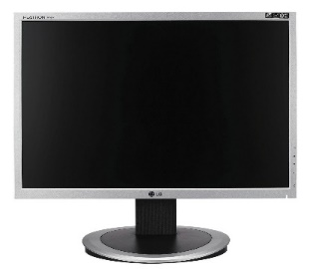
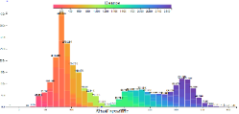
Browsing big data
Interactive visualization of billion row datasets
Slice and dice data with the click of a mouse
No coding required
http://github.com/vmware/hillview
Apache 2 license

Slide 3


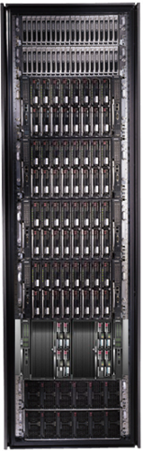
Bandwidth hierarchy
These channels are lossy!
Compute approximate data views with an error < channel error.

Slide 4
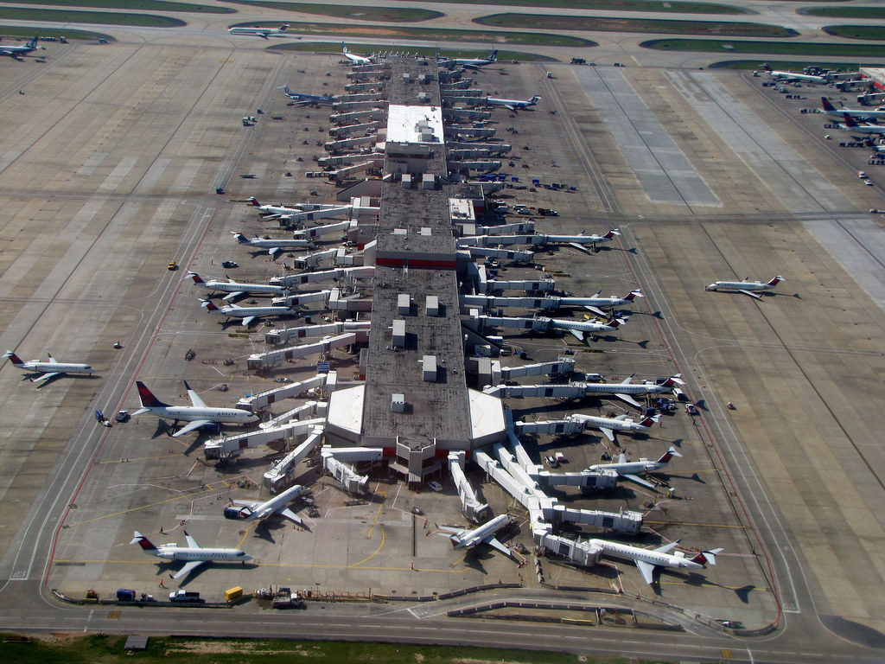
Demo
Browsing a 124 million rows table
  .5M flights/month
  All US flights in last 20 years
  Public data from FAA website
Running on 20 small VMs
(5GB of RAM, 4 CPU cores each)

Slide 5




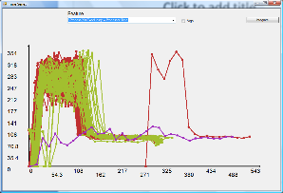
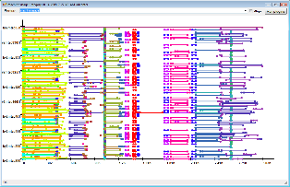
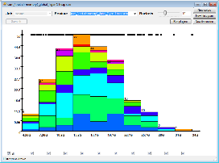
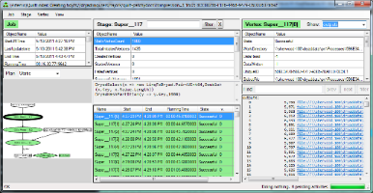

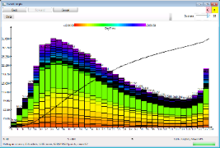
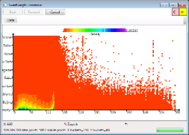
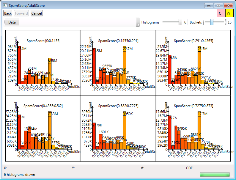
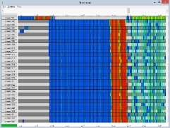
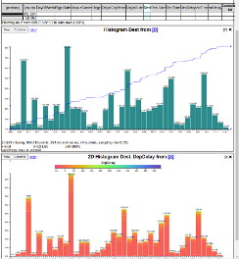
History
2006 | Dryad (Eurosys 2007) deployed by Microsoft Live Search
2008 | DryadLINQ (OSDI 2008); Artemis DryadLINQ job profiler (WASL 2008)
2011 | Daphne DryadLINQ job debugger (HIPS 2011); Fay distributed safe tracing (SOSP 2011)
2014 | Sketch spreadsheet (EGPGV 16) [MSR SVC closed]
2016

Slide 6

Outline
Motivation
Fundamental building blocks
System architecture
Visualization as sketches
Evaluation
Conclusion

Slide 7
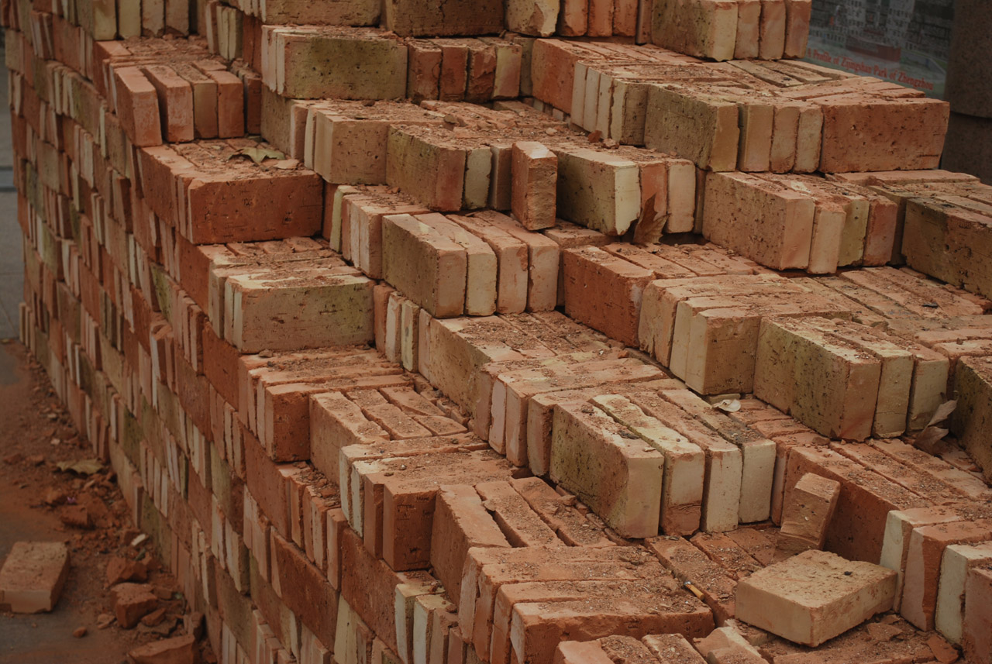
Hillview Building Blocks

Slide 8
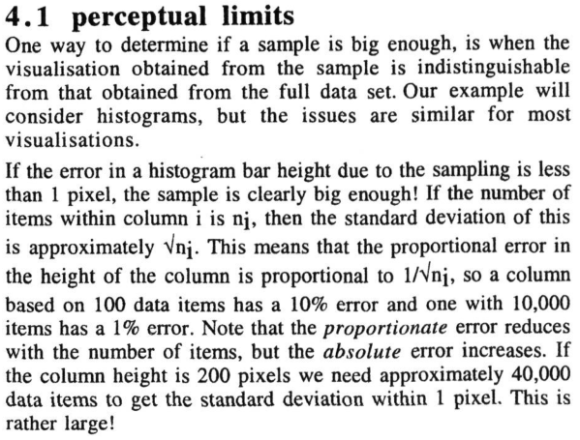

Approximate renderings

Slide 9

Monoids
A set M with
  An operation + : M x M -> M
  A distinguished zero element: a + 0 = 0 + a = a
  Commutative if a + b = b + a
interface IMonoid<R> {
R zero();
R add(R left, R right);
}

Slide 10
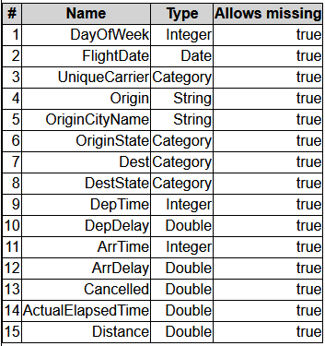
Abstract Computational Model
Output O
Post
processing
“sketch”
R must be “small”
(independent on N,
dependent on screen size)
R
add
R
R
add
add
R
R
R
R
Streaming
algorithm
sketch
sketch
sketch
sketch
Input data, sharded
Multi-set of N tuples

Slide 11
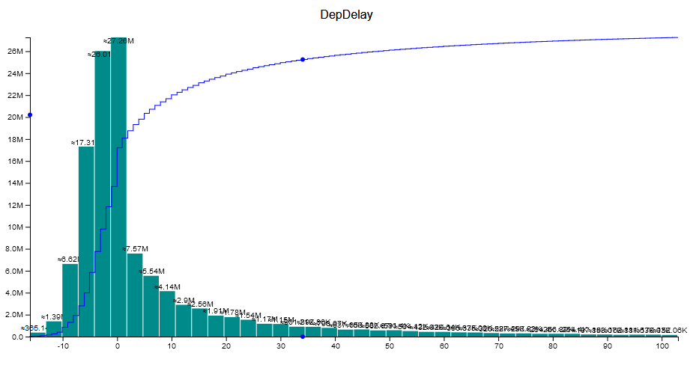
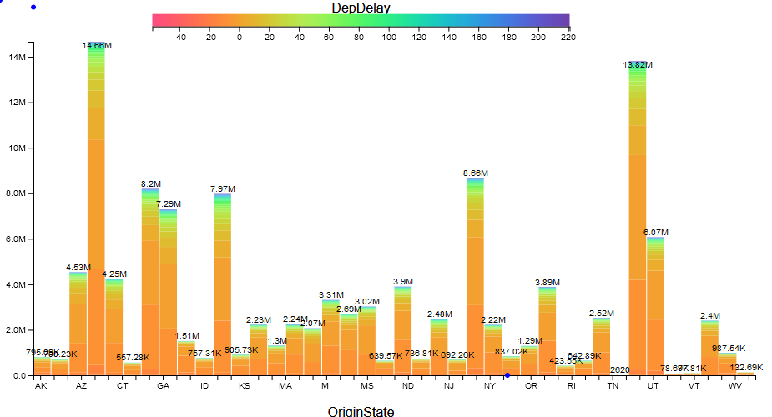
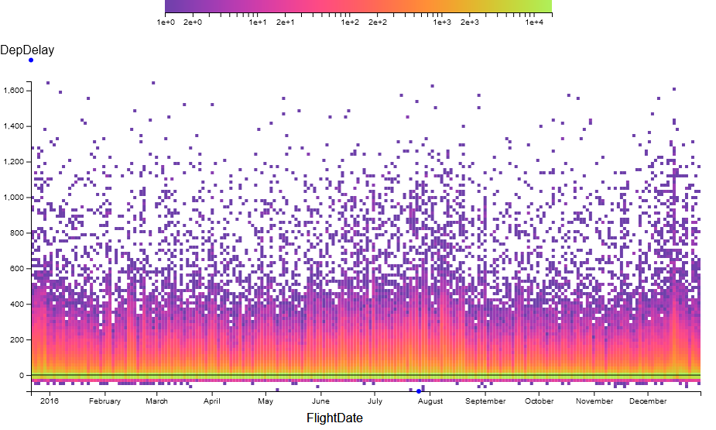
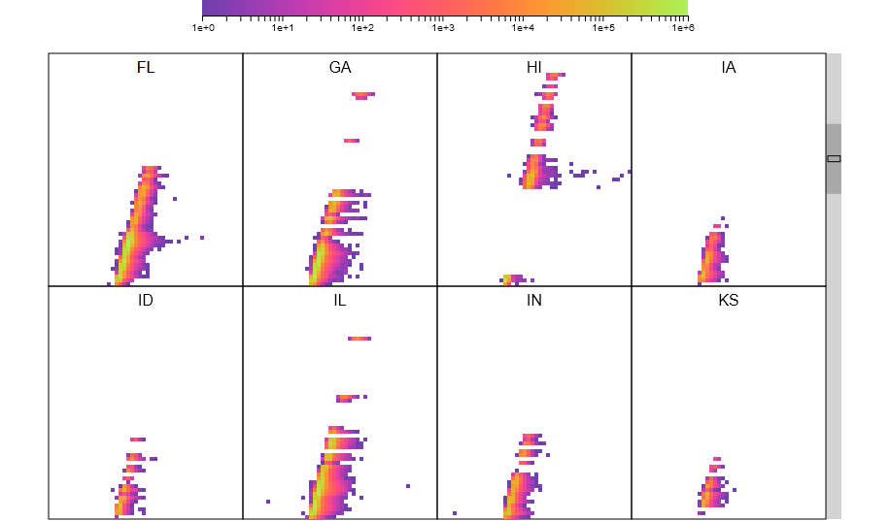
All Renderings in Hillview are sketches!

Slide 12
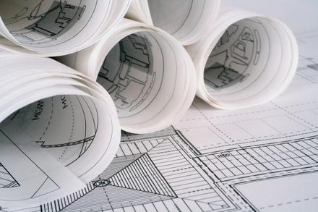
System architecture

Slide 13
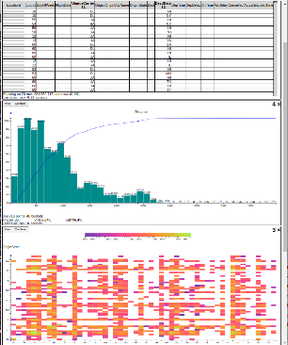


Hillview System architecture
Leaf
node
In-memory
table
parallel
read
Aggregation
node
Leaf
node
In-memory
table
Web
front-end
Root
node
In-memory
table
Storage
Leaf
node
In-memory
table
request
In-memory
table
Storage
Remote
tables refs.
Leaf
node
In-memory
table
streaming
response
Aggregation
node
In-memory
table
Storage
Redo log
In-memory
table
Client
web browser
Storage
Aggregation
network
Cloud service
workers

Slide 14
DataSet Core API
interface ISketch<T,R> extends IMonoid<R> {
R sketch(T data);
}
interface PR<T> { // Partial result
T data;
double done;
}
interface IDataSet<T> {
Observable<PR<R>> sketch(ISketch<T,R> sk);
… map(…);
… zip(…);
}

Slide 15
Immutable Partitioned Objects
browser
handle
root node
Address spaces
Network
IDataSet<T>
T
T
T
T
T
T
T
T
T
T
T
Workers

Slide 16
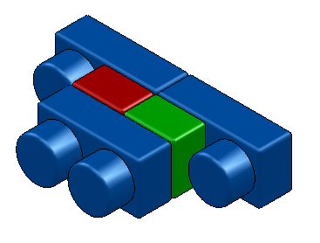
Dataset objects
Implement IDataSet<T>
Identical interfaces on top and bottom
Can be stacked arbitrarily
Modular construction of distributed systems
IDataSet
interface

Slide 17
LocalDataset<T>
Contains a reference to an object of type T
in the same address space
Directly executes operations (map, sketch, zip)
on object
Local
T

Slide 18
ParallelDataset<T>
Has a number of children of type IDataSet<T>
Dispatches operations to all children
  sketch adds the results of children
Parallel

Slide 19
RemoteDataset<T>
Has a reference to an IDataSet<T>
in another address space
The only component that deals with the network
Built on top of GRPC
Client
Remote
ref
GRPC
Server

Slide 20
A distributed dataset
Root node
Parallel
Remote
Remote
Network
worker 0
ref
worker 1
ref
ref
worker n
Parallel
Parallel
Remote
Parallel
Parallel
Local
Local
Local
Local
Local
Local
T
T
Rack 0
T
T
T
Rack r
T

Slide 21
sketch(s)
interface ISketch<T,R> extends IMonoid<R> {
R sketch(T data);
}
R
Remote
s.add
R
Parallel
R
R
Local
Local
s.sketch
T
T

Slide 22
Histogram execution timeline
Progress
report
Render
User
click
Data
range
Initiate
histogram
Completed
Client
Web server
Data
range
Histogram
+ CDF
Worker 1
Time
Compute
Worker n
Full scan
Sampled scan

Slide 23
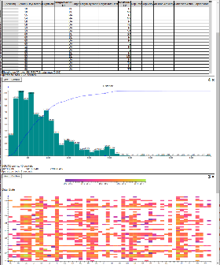
Memory management
Web
front-end
Root
node
Leaf
node
In-memory
table
Memoization
cache
Remote
tables refs.
In-memory
table
Storage
Redo log
Soft state (cache)
Log = lineage of all datasets
Log = JSON messages received from client
Replaying the log reconstructs all soft-state
Log can be replayed as needed

Slide 24

Visualization as sketches

Slide 25
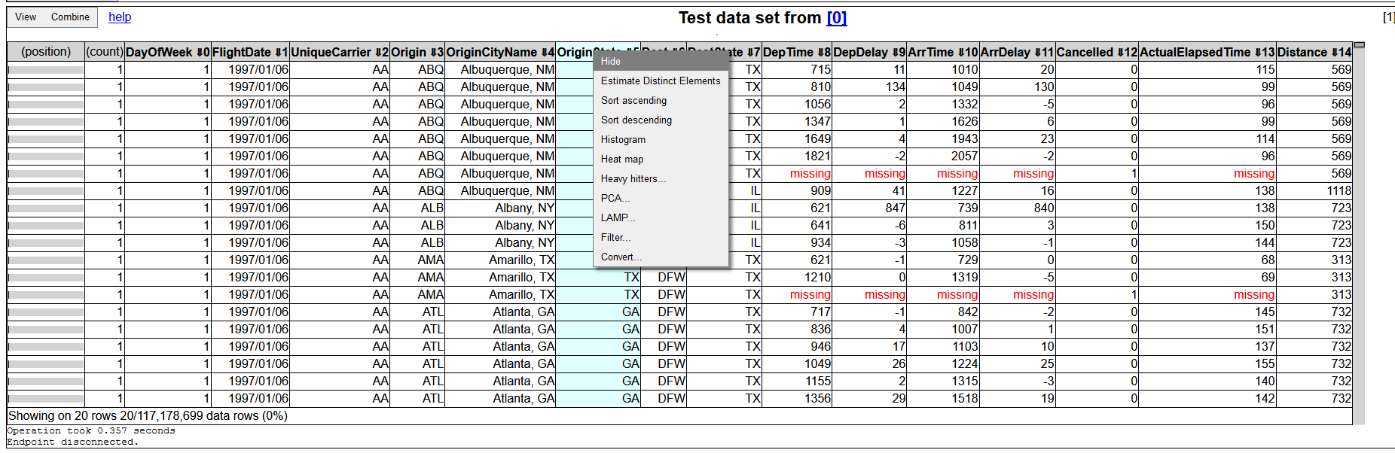
Table views
Always sorted
NextK(startTuple, sortOrder, K)
Monoid operation is “merge sort”

Slide 26
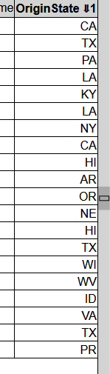
Scrolling
Compute startTuple based on
scroll-bar position
  Approximate quantile
  Samples O(H²) rows;
  H = screen height in pixels

Slide 27
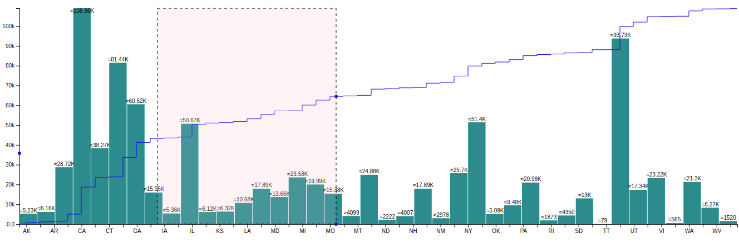
1D Histograms
CDF
Histograms are monoids (vector addition)
CDFs are histograms (at the pixel level)

Slide 28
Histograms based on sampling
Exact histogram
Approximate histogram
μ < 1/2
Actual
Legal rendering
Actual
Legal rendering
Legal rendering
pixel row
Theorem: O((HB / μ)² log(1/δ)) samples are needed to compute
an approximate histogram with probability 1 – δ.
H = screen size in pixels
B = number of buckets (< screen width in pixels)
No N in this formula!

Slide 29
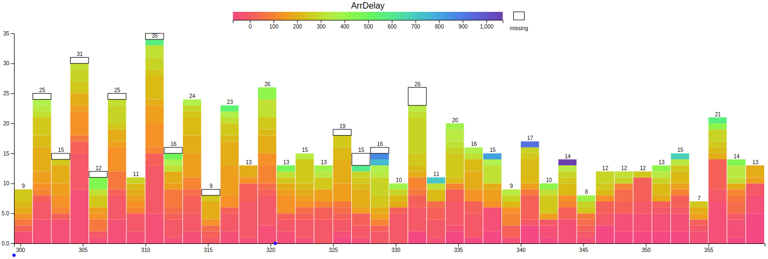
2D Histograms

Slide 30
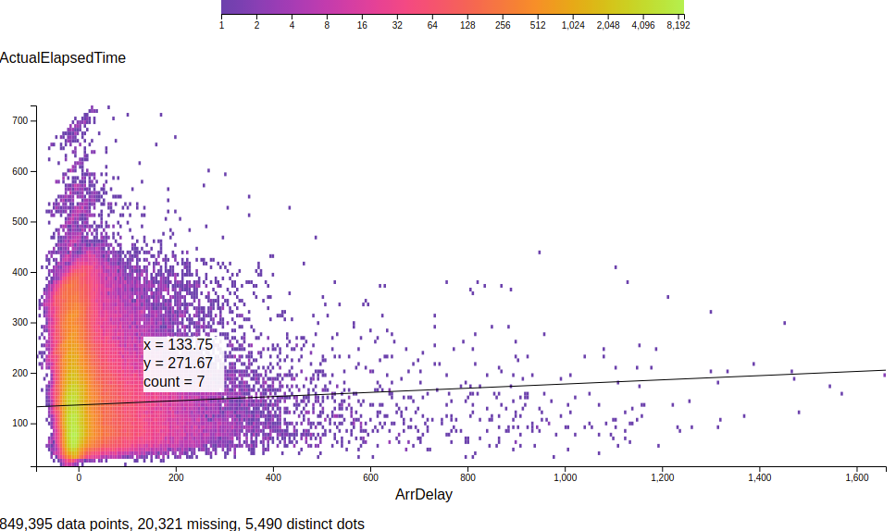
Heatmaps
Linear regression

Slide 31
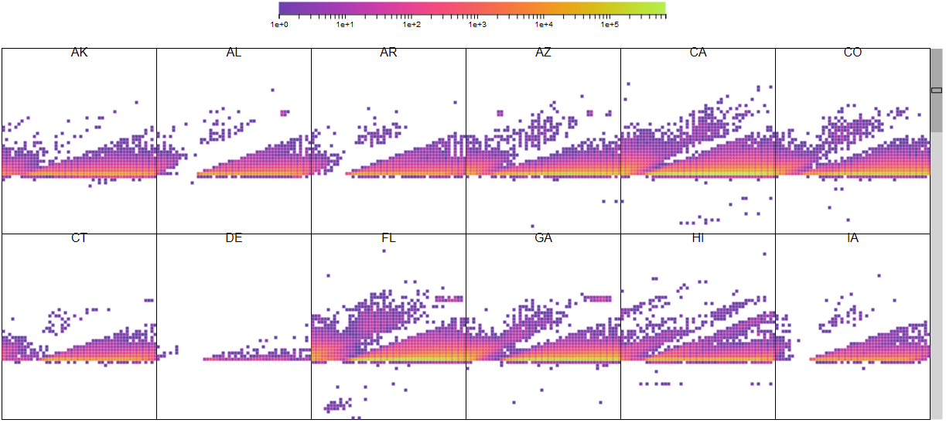
Trellis plots

Slide 32

Evaluation

Slide 33
Evaluation system
TOR switch
LAN
Web front-end
Root aggregator
Workers, aggregator
5 servers
Intel Haswell-EP 2.4GHz
(2 sockets x 8 cores x
2 hyperthreads)
128GB RAM/machine
Ubuntu Server 16.10, Linux 4.8
40Gbps Ethernet in rack
client
Workers, aggregator
Workers, aggregator
Workers, aggregator
Workers, aggregator
rack

Slide 34
Cost of Single-Threaded Implementation
histogram of 100M double values
1 thread, no range computation, no sampling, no CDF
Remote
Local
data

Slide 35
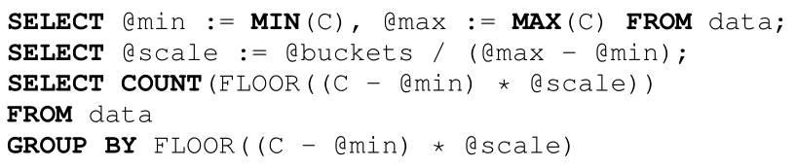
Comparison against database
Commercial database [can’t tell which one]
In-memory table
100M rows
DB takes 5,830ms (Hillview is 590ms)

Slide 36
Single-machine, weak scaling
Histogram, 100M elements/shard, no sampling

Slide 37
Cluster-level weak scaling
Histogram, 100M elements/shard, 32 shards/machine
Computation gets faster as dataset size grows!

Slide 38
End-to-end time (ms)
Operation | 124M rows | 1,240M rows
Range + Histogram & CDF | 180 | 394
Filter + Range + Histogram & CDF | 323 | 739
Heavy hitters | 82 | 339
Sort 5 columns | 210 | 671
Range + sampled histogram [SPARK, cached RDD, no UI] | 590+660

Slide 39
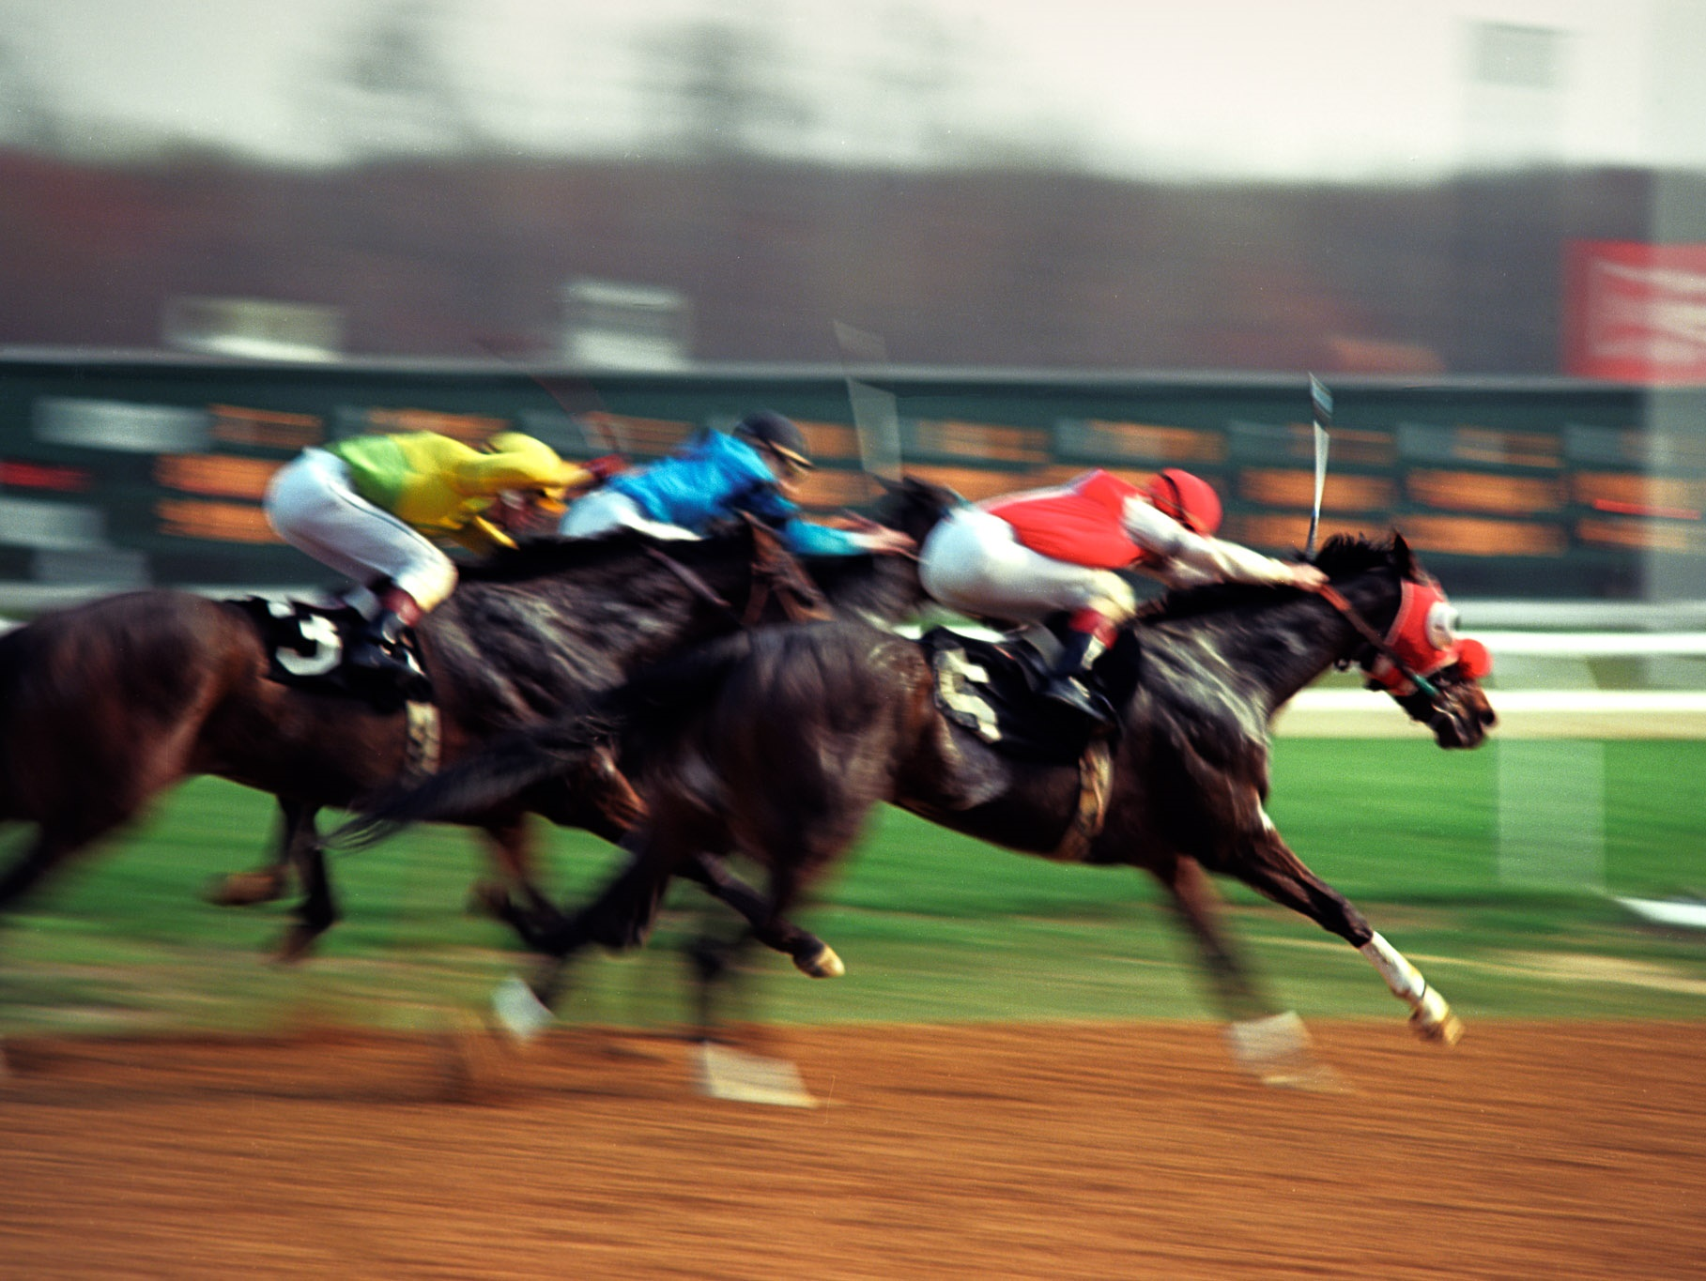
Conclusion

Slide 40

Lessons learned
- architecture
Always think asymptotics (data size/screen size)
Define “correct approximation” precisely
Small renderings make browser fast
Two kinds of visualizations: trends and outliers
Don’t forget about missing data!

Slide 41

Lessons learned
- implementation
Java needs value types
JavaScript is a
Sampling is not free; full scans may be cheaper
Redo log => simple memory management
  But data must be immutable
  All computations must be deterministic

Slide 42
Related work [a small sample]
Big data visualization
  Databases, commercial products
  Polaris/Tableau, IBM BigSheets, inMens, Nanocubes, Hashedcubes, DICE, Erma, Pangloss, Profiler, Foresight, iSAX, M4, Vizdom, PowerBI
Big data analytics for visualization
  MPI Reduce, Neptune, Splunk, MapReduce, Dremel/BigQuery, FB Scuba, Drill, Spark, Druid, Naiad, Algebird, Scope, ScalarR
Sampling-based analytics
  BlinkDB, VisReduce, Sample+Seek, G-OLA
Incremental visualization
  Online aggregation, progressive analytics, ProgressiVis, Tempe, Stat, SwiftTuna, MapReduce online, EARL, Now!, PIVE, DimXplorer

Slide 43
Future work
Deploy
Integrate with other data sources/analytics engines
More intelligence in the tool
Time-series support
minutes
Big data storage
Big data
analytics
seconds
Hillview
visualization
commands

Slide 44
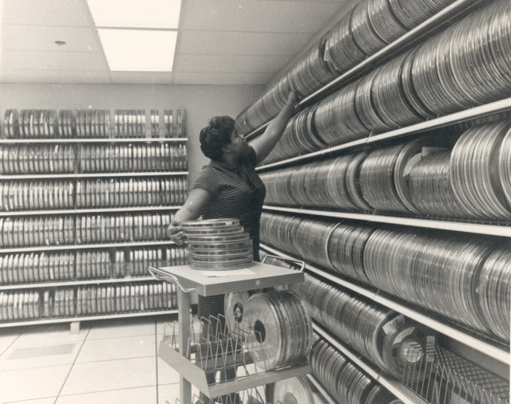
Backup slides

Slide 45
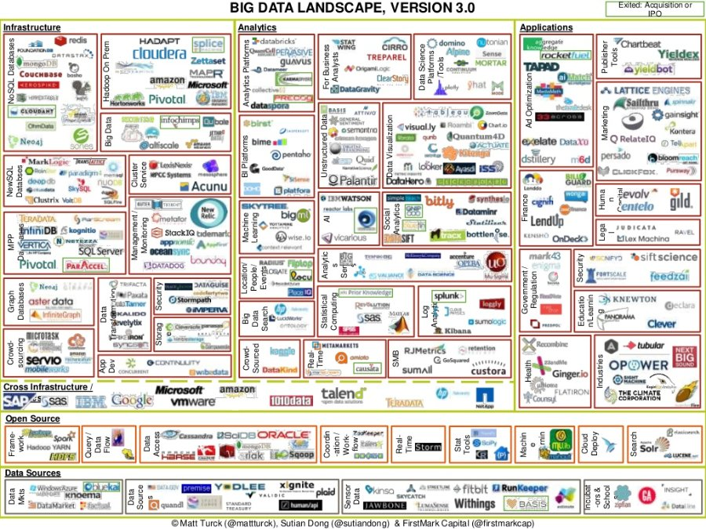
Most tools require significant expertise

Slide 46

Linear transformations (homomorphisms)
Linear functions between monoids:
f: M → N, f(a + b) = f(a) + f(b)
“Map” and “reduce” are linear functions
Linear transformations are the essence of data parallelism
Many streaming algorithms are linear transformations

Slide 47
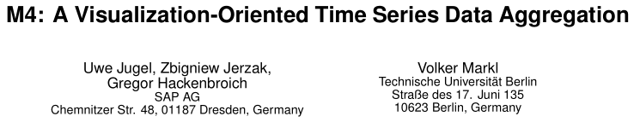
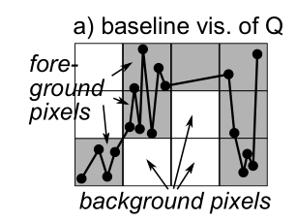
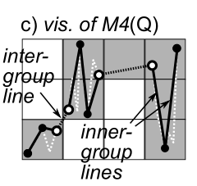
Pixel-level quantization

Slide 48

Reactive streams (RxJava)
interface Observable<T> {
Subscription subscribe(Observer<T> observer);
}
interface Observer<T> {
void onNext(T value);
void onError(Throwable error);
void onCompleted();
}
March 2012

Slide 49

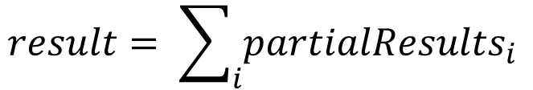
Observable roles (1)
Streaming data
Observable<R> partialResults;
$$result= \sum_{i}{{partialResults}_{i}}$$

Slide 50
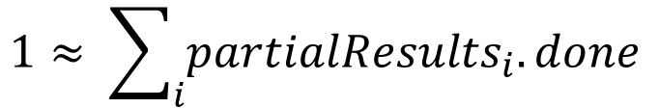
Observable roles (2)
Distributed progress reporting
class PR<T> { // A partial result
double done;
T data;
}
Observable<PR<R>> partialResults;
$$1≈ \sum_{i}{{partialResults}_{i}.done}$$

Slide 51

Observable roles (3)
Distributed cancellation
Sketch API (C#)
async R map(Func<T, R> map, CancellationToken t, Progress<double> rep)
CancellationToken ct = cancellationTokenSource.token;
Progress<double> reporter;
R result = data.map(f, ct, reporter);
…
cancellationTokenSource.cancel();
Hillview API
Observable<PR<R>> map(Function<T, R> map);
Observable<PR<R>> o = data.map(f);
Subscription s = o.subscribe(observer);
…
s.unsubscribe();

Slide 52

Observable roles (4)
Concurrency management
Observable<T> data;
Observable<T> output = data.subscribeOn(scheduler);

Slide 53
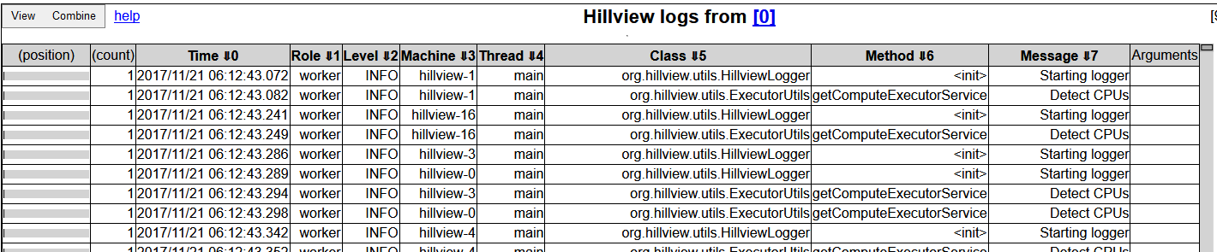
A log browser in Hillview
Spreadsheet
DataSet<Table>
Log parser
Distributed logs

Slide 54
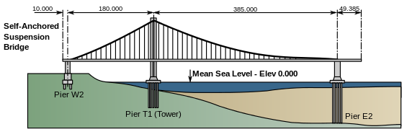
Hillview Design principles
Take display and perception limits into account
Wherever possible compute on sampled data
Compute views lazily (when users need them)
Shard data to exploit parallelism and increase responsiveness
Push computation to data
Only use sketching algorithms
Avoid hard state
Functional programming; immutable objects
Incremental view updates

Slide 55
map(f)
Remote
Remote
Parallel
Parallel
Local
Local
Local
Local
T
T
S
S
f
f

Slide 56
zip
Remote
Remote
Remote
Parallel
Parallel
Parallel
Local
Local
Local
Local
Local
Local
T
T
S
S
T,S
T,S

Slide 57
Spreadsheet architecture
UI
Front-end
DataSet<Table>
Distributed objects
Table operations
Spreadsheet logic
SQL DB
CSV Files
Column store
…
Storage layer

Slide 58
Table data storage
Table₁
Table₂
Schema₁
Columns
Columns
Schema₂
Membership
set
Membership
set
Column
data

Slide 59

MembershipSet operations
Iterate
Sample
GetIteratorOverSample
  Ideally cost should be O(|output|)
Union/intersection/etc.
Multiple implementations, depending on sparsity

Slide 60

Scripting
We expose JavaScript to users
  Create new columns
  Write data filters
Oracle Java Nashorn JS engine

Slide 61
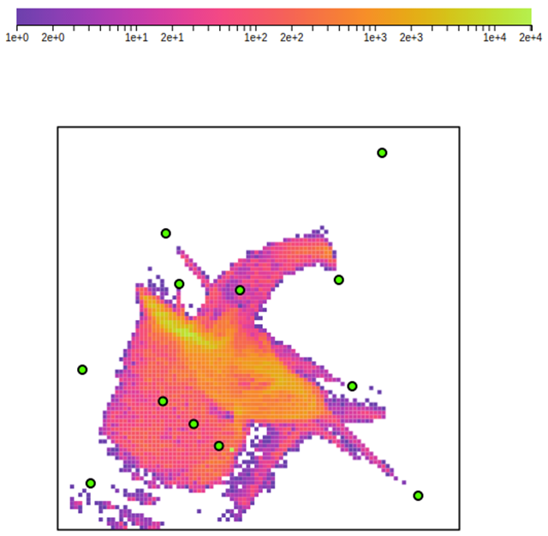
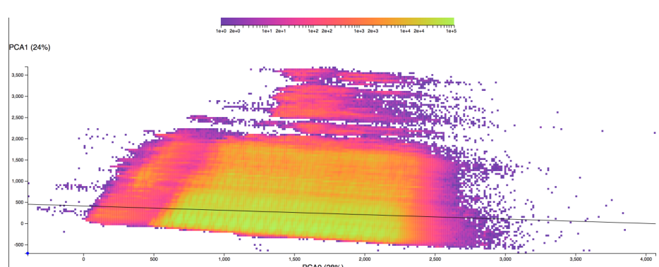
Dimensionality reduction
PCA
Covariance matrix computation is a sketch
Local Affine Multidimensional Scaling

Slide 62
Single machine, strong scaling
Histogram, 100M elements total, no sampling

Slide 63
Service capacity

