Slide 1

P4 demo: a basic L2/L3 switch in 170 LOC
netdev0.1
Ottawa, February 15, 2015
Mihai Budiu

Slide 2



Setup
Router control
Table access API
P4 program
h1
RPC
h2
P4 compiler
Tables
Data plane
P4 software switch
Mininet
Notes:
﻿cd p4factory/targets/simple_router
make behavioral
cd ../../..
﻿cd mininet-demo
sudo python 1sw_demo.py --behavioral-exe ../p4factory/targets/simple_router/behavioral-model

Slide 3

DEMO PART 1
Creating a basic ethernet+IPv4 switch from a P4 program
P4 program
Tables
P4 compiler
Data plane
P4 compiler
P4 software switch

Slide 4
Layer 3 packet forwarding
Control plane
IPv4.dst ->
nextHop.ipv4address,
outputPort,
ipv4.ttl
nextHop.ipv4address ->
ethernet.dst_addr
outputPort ->
ethernet.src_addr
Packet
Packet
Notes:
﻿mininet> h1 wireshark &
mininet> h1 ping h2 # this should fail
$ ﻿./simple_router_control --thrift-path ../p4factory/targets/simple_router/of-tests/pd_thrift < commands.txt
mininet> h1 ping h2 # this should succeed

Slide 5

Headers
header_type ethernet_t {
fields {
dstAddr: 48;
srcAddr: 48;
etherType: 16;
}
}
header_type ipv4_t { … }
// no options

Slide 6
Parser
﻿parser parse_ethernet {
extract(ethernet);
return select(latest.etherType) {
0x0800 : parse_ipv4;
default: ingress;
}}
…
parser parse_ipv4 { … }
calculated_field ipv4.hdrChecksum {
verify ipv4_checksum;
update ipv4_checksum;
}

Slide 7
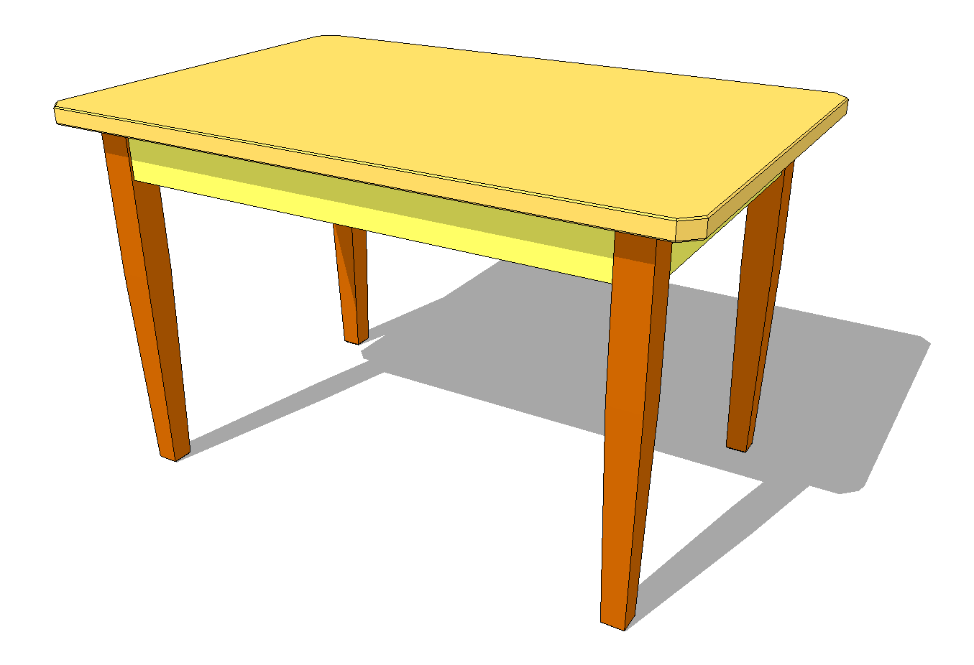
Last table
action rewrite_mac(smac) {
modify_field(ethernet.srcAddr, smac);
}
table send_frame {
reads { std_metadata.egress_port: exact; }
actions {
rewrite_mac;
drop;
}
size: 256;
}
outputPort ->
ethernet.src_addr

Slide 8

Complete pipeline
control ingress {
apply(ipv4_match);
apply(forward);
}
control egress {
apply(send_frame);
}

Slide 9
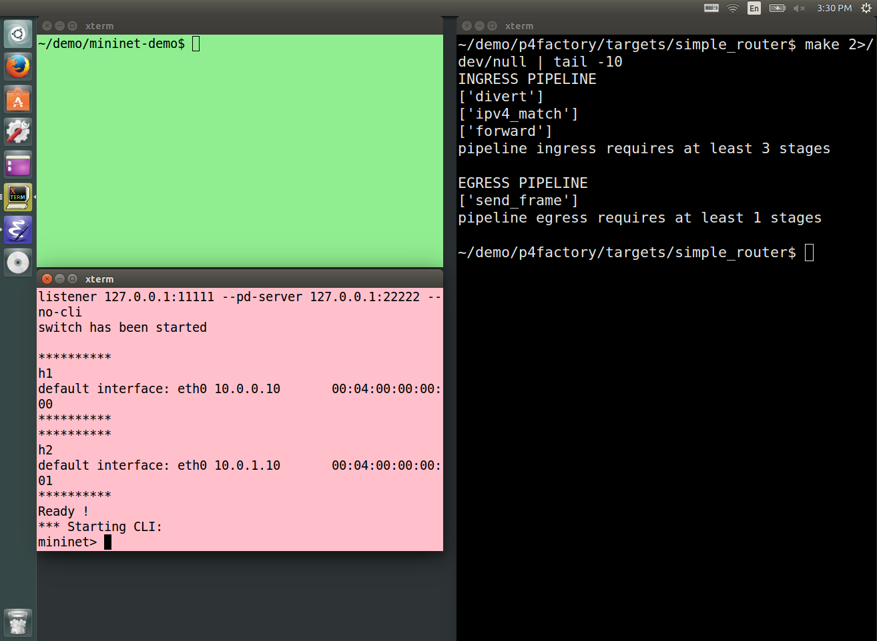
2. Started switch running
1. Compiled a new switch from P4

Slide 10
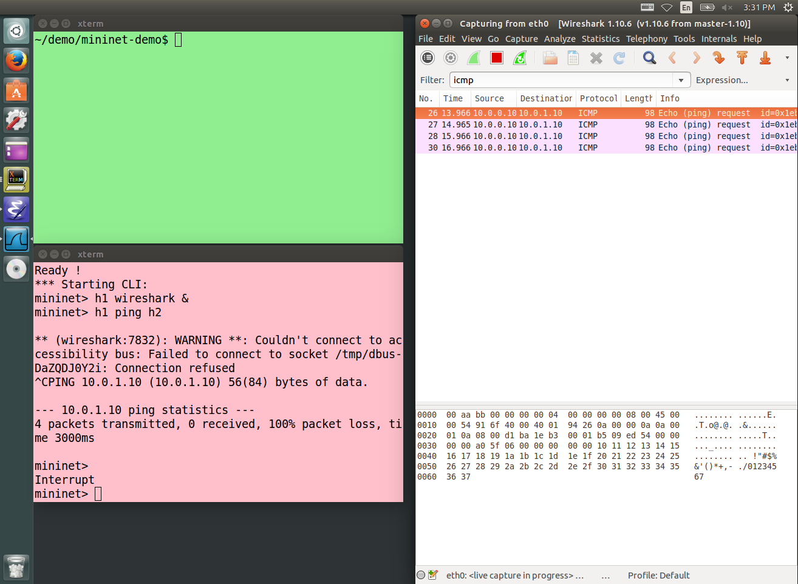
1. Running wireshark on h1
2. Ping from h1 to h2 does not work
3. Pings sent but no reply returned

Slide 11
DEMO PART 2
Router control
Table access API
Populate switch tables
to enable forwarding
RPC
Tables
Data plane
P4 software switch

Slide 12
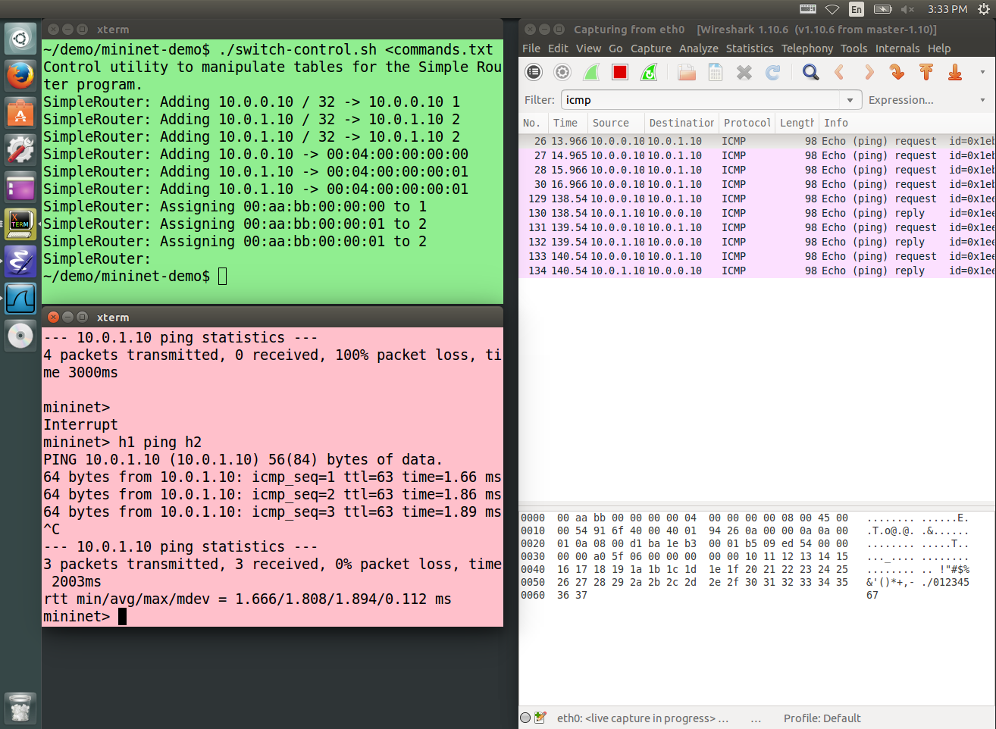
1. Populated all tables; ping starts running
2. Pings sent and reply received

Slide 13

DEMO PART 3
Counters in the datapath

Slide 14
Adding counters to table entries
counter send_frame_bytes
{
type : bytes;
direct : send_frame;
}
output_port | Action
counter
Table send_frame

Slide 15
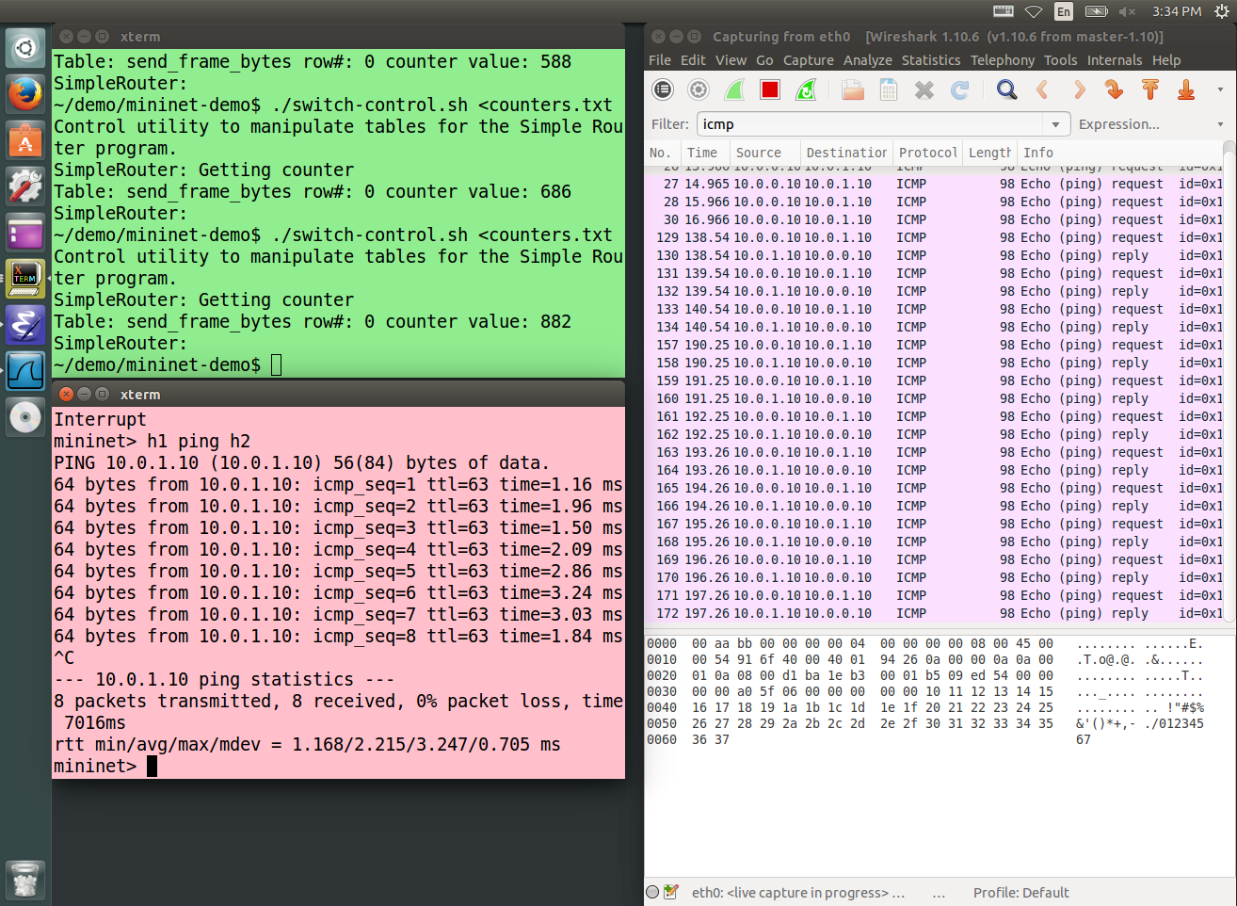
Reading byte counters while ping is running

Slide 16

DEMO PART 4
Divert traffic

Slide 17
Diverting traffic
Divert traffic for specific destinations
to another destination
IPv4.dst ->
IPv4.dst
IPv4.dst ->
nextHop.ipv4address,
outputPort,
ipv4.ttl
nextHop.ipv4address ->
ethernet.dst_addr
outputPort ->
ethernet.src_addr
Notes:
$ ﻿./simple_router_control --thrift-path ../p4factory/targets/simple_router/of-tests/pd_thrift < divert.txt
Mininet> h1 ping h2 # this should fail, but wireshark shows packet coming back

Slide 18
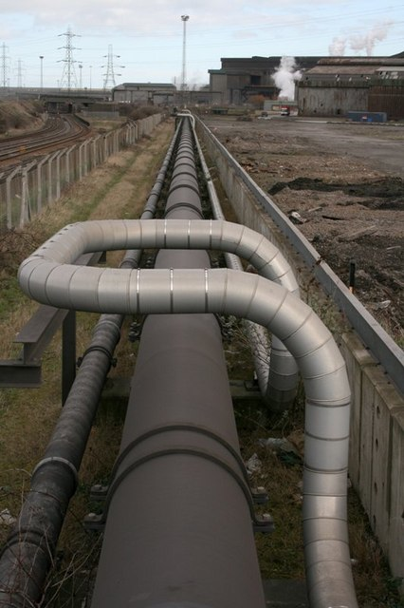
Modified pipeline
control ingress {
apply(divert);
apply(ipv4_match);
apply(forward);
}
control egress {
apply(send_frame);
}
Notes:
﻿./simple_router_control --thrift-path ../p4factory/targets/simple_router/of-tests/pd_thrift
SimpleRouter: get_ctr send_frame_bytes 0
<reply>
SimpleRouter: ^D

Slide 19
Diverting traffic
action replaceIp(ipdest) {
modify_field(ipv4.dstAddr, ipdest);
}
table divert {
reads { ipv4.dstAddr: exact;}
actions {
replaceIp;
nop;
}
size: 256;
}

Slide 20
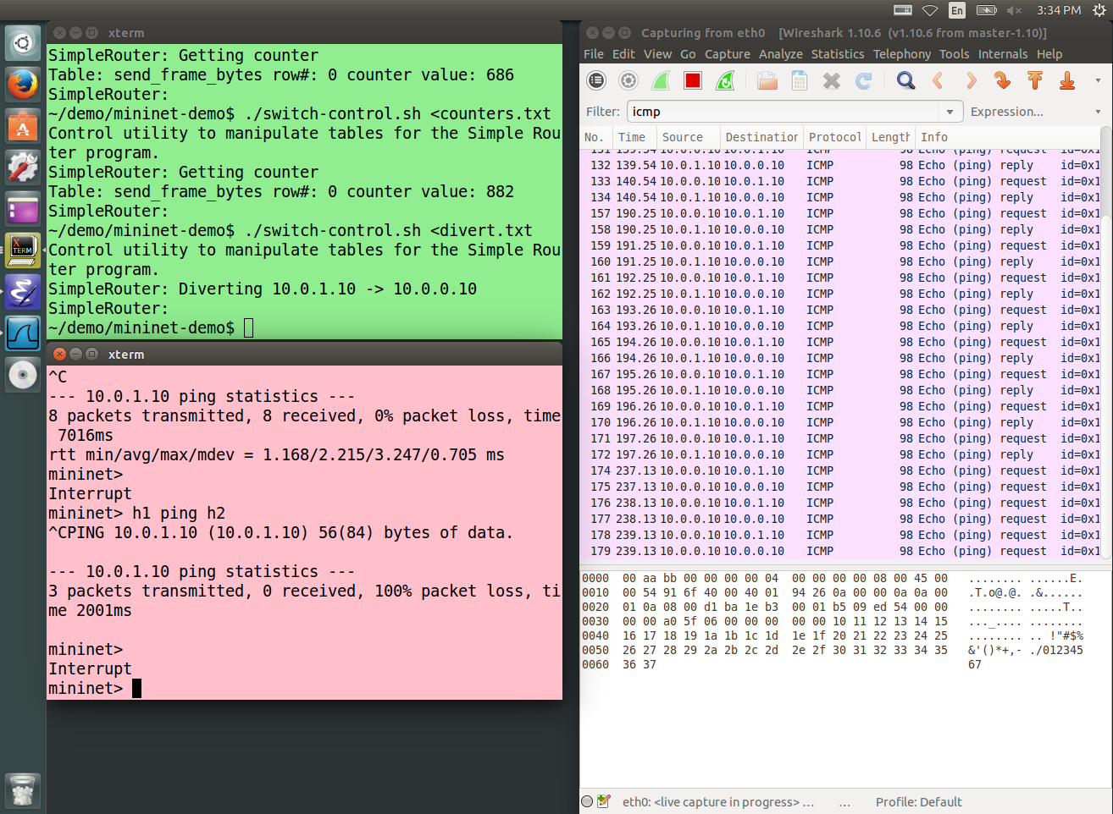
1. Inserted table entries to divert packets
2. Pings sent and received by same host

Slide 21

Availability
All this code will be available
as FOSS
before March 31, 2015
on http://p4.org

