Slide 1
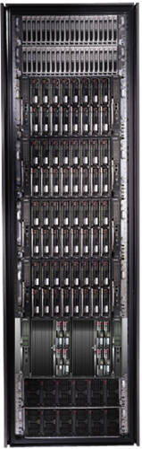
Data-Intensive
Cluster Computing
Mihai Budiu
Microsoft Research, Silicon Valley
SJSU Cloud Computing Course
April 15, 2014

Slide 2
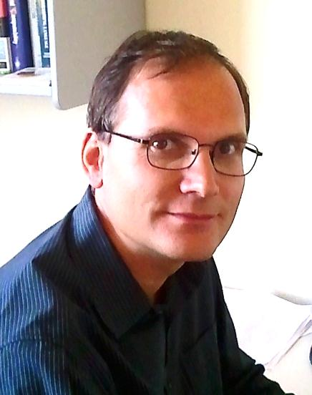
About Myself
http://budiu.info/work
Senior Researcher at Microsoft Research
in Mountain View
Ph.D. in Computer Science from
Carnegie Mellon, 2004
Worked on reconfigurable hardware, compilers, security, cloud computing, performance analysis
I worked on most software layers that I am presenting today

Slide 3

Lessons to remember
I will use this symbol throughout the presentation to point out fundamental concepts and ideas.
This talk is not about specific software artifacts. It is a talk about principles, illustrated with some existing implementations.

Slide 4


Big Data

Slide 5
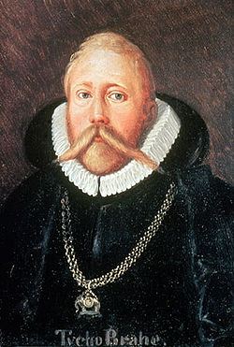
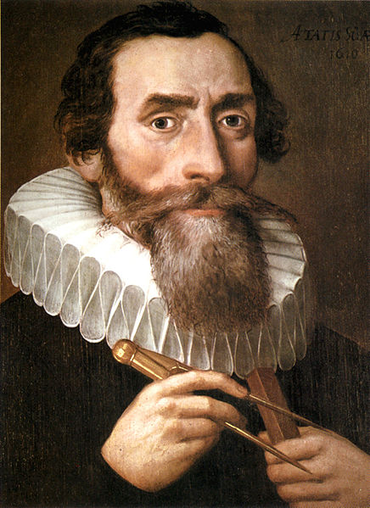
500 Years Ago
Tycho Brahe
(1546-1601)
Johannes Kepler
(1571-1630)
Notes:
Images from Wikipedia

Slide 6
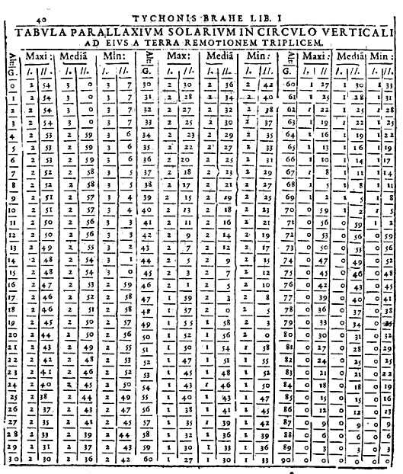
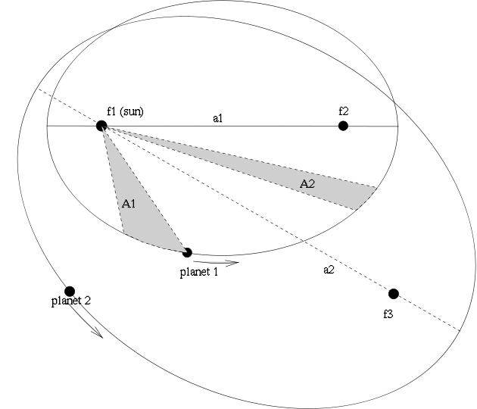
The Laws of Planetary Motion
Tycho’s measurements
Kepler’s laws
Notes:
Left image from Google Books.
Right image from Wikipedia.

Slide 7
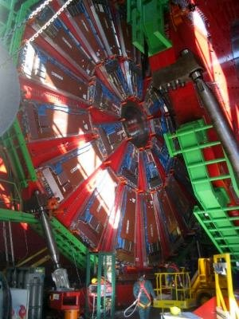
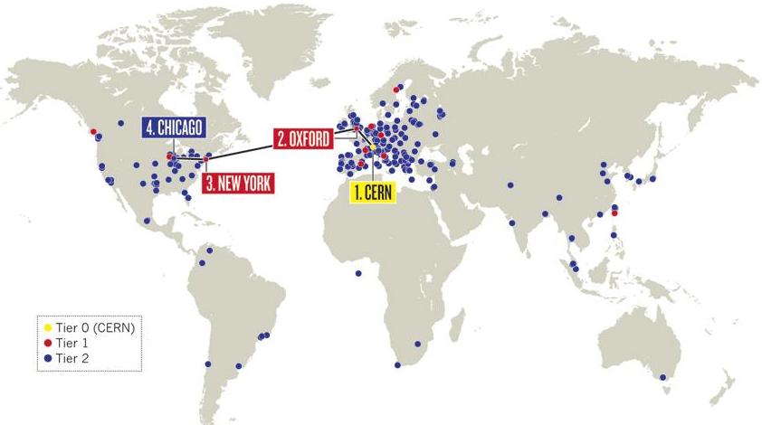
The Large Hadron Collider
LHC Grid:
200K computing cores
15 PB/year
Notes:
Left image from Wikipedia.
Right image from Nature.com

Slide 8
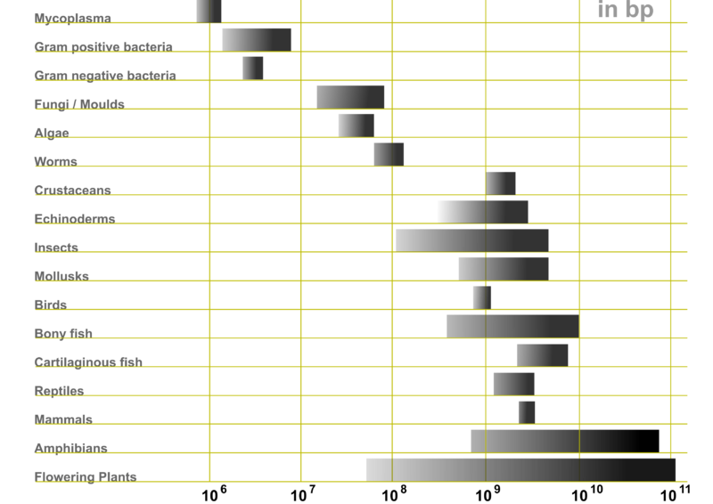
Genetic Code
Notes:
Image from Wikipedia

Slide 9
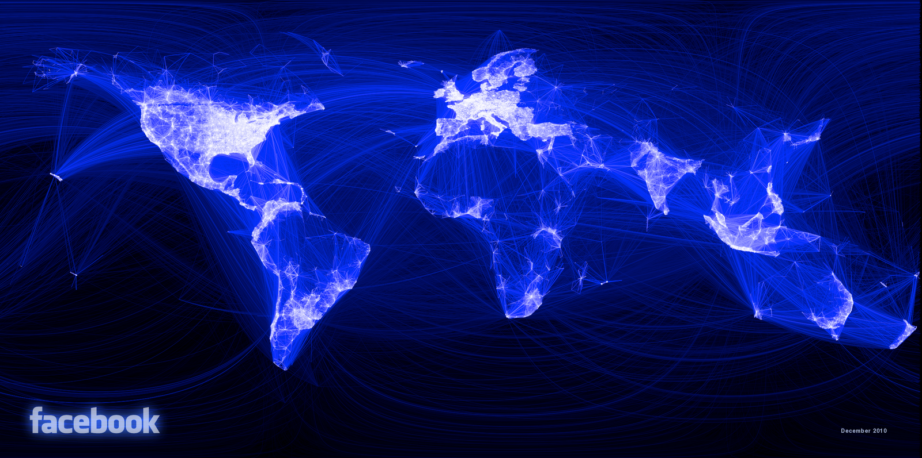
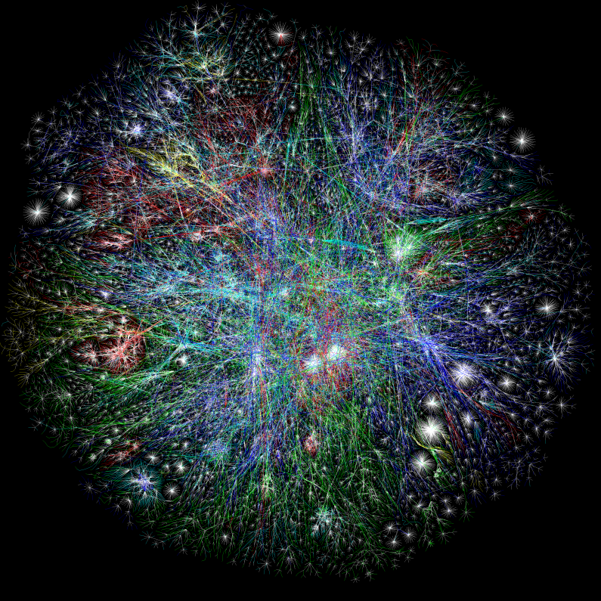
The Webs
Facebook friends graph
Internet
Notes:
Left image from Opte.org
Right image from facebook.com

Slide 10

Big Data

Slide 11


Big Computers

Slide 12
Crunching
Big Data
Big Dat

Slide 13
Design Space
Grid
Internet
Data-
parallel
Search
X
Shared
memory
Data
center
Transaction
HPC
Latency
(interactive)
Throughput
(batch)
Notes:
Dryad is optimized for: throughput, data-parallel computation, in a private data-center.

Slide 14
Software Stack
Applications
Language
Distributed Execution
Storage
Higher abstractions
Cluster
Deployment
Machine
Machine
Machine
Machine

Slide 15
Cluster Architecture
Applications
Language
Distributed Execution
Cluster storage
Cluster services
Deployment
Machine
Machine
Machine
Machine

Slide 16
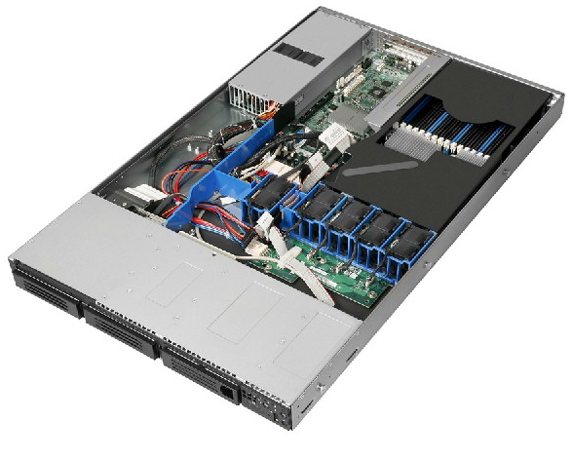
Cluster Machines
Commodity server-class systems
Optimized for cost
Remote management interface
Local storage (multiple drives)
Multi-core CPU
Gigabit+ Ethernet
Stock OS

Slide 17
Cluster network topology
To next level switch
top-level switch
top-of-rack switch
rack

Slide 18
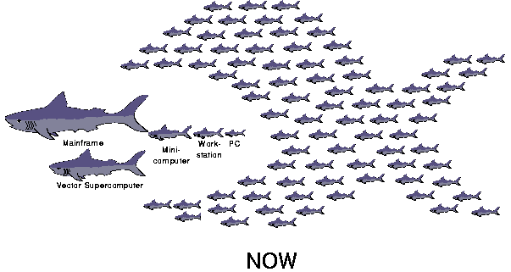
The secret of scalability
Cheap hardware
Smart software
Berkeley Network of Workstations (’94-’98)
http://now.cs.berkeley.edu

Slide 19
Deployment: Autopilot
Applications
Language
Distributed Execution
Cluster storage
Cluster services
Deployment
Machine
Machine
Machine
Machine

Slide 20


Autopilot goal
Handle automatically routine tasks
Without operator intervention

Slide 21
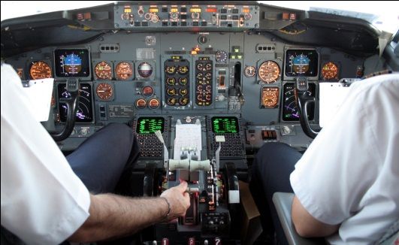
Autopiloted System
Autopilot control
Application
Autopilot services

Slide 22
Recovery-Oriented Computing
Everything will eventually fail
Design for failure
Crash-only software design
http://roc.cs.berkeley.edu
Brown, A. and D. A. Patterson. Embracing Failure: A Case for Recovery-Oriented Computing (ROC). High Performance Transaction Processing Symposium, October 2001.

Slide 23

Autopilot Architecture
Discover new machines; netboot; self-test
Install application binaries and configurations
Monitor application health
Fix broken machines
Operational data collection and visualization
Provisioning
Deployment
Watchdog
Repair
Device Manager

Slide 24
Distributed State
Distributed state
Replicated
Weakly consistent
Provisioning
Deployment
Watchdog
Repair
Device Manager
Centralized state
Replicated
Strongly consistent

Slide 25
Centralized Replicated Control
Keep essential control state centralized
Replicate the state for reliability
Use the Paxos consensus protocol
Leslie Lamport. The part-time parliament. ACM Transactions on Computer Systems, 16(2):133{169, May 1998.
Paxos

Slide 26
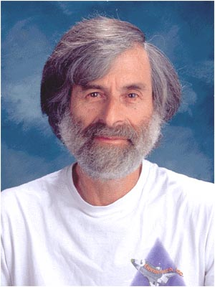
Leslie Lamport
2013 ACM A.M. Turing Award Winner
For imposing clear, well-defined coherence on the seemingly chaotic behavior of distributed computing systems, in which several autonomous computers communicate with each other by passing messages. He devised important algorithms and developed formal modeling and verification protocols that improve the quality of real distributed systems. These contributions have resulted in improved correctness, performance, and reliability of computer systems.

Slide 27
Autopilot abstraction
Self-healing machines
Deployment
Machine
Machine
Machine
Machine

Slide 28
Cluster Services
Applications
Language
Distributed Execution
Cluster storage
Cluster services
Deployment
Machine
Machine
Machine
Machine

Slide 29
Cluster Services
Name service: discover cluster machines
Scheduling: allocate cluster machines
Storage: file contents
Remote execution: spawn new computations

Slide 30
Cluster Machines
Remote
execution
Storage
Remote
execution
Storage
Name service
Scheduling

Slide 31
Cluster services abstraction
Reliable specialized machines
Cluster services
Deployment
Machine
Machine
Machine
Machine

Slide 32

Layered Software Architecture
Simple components
Software-provided reliability
Versioned APIs
Design for live staged deployment

Slide 33
DISTRIBUTED Storage
Applications
Language
Distributed Execution
Cluster storage
Cluster services
Deployment
Machine
Machine
Machine
Machine

Slide 34
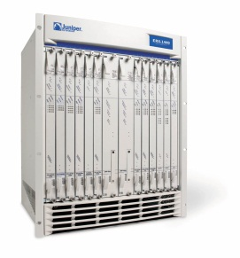
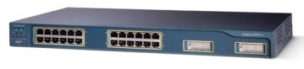
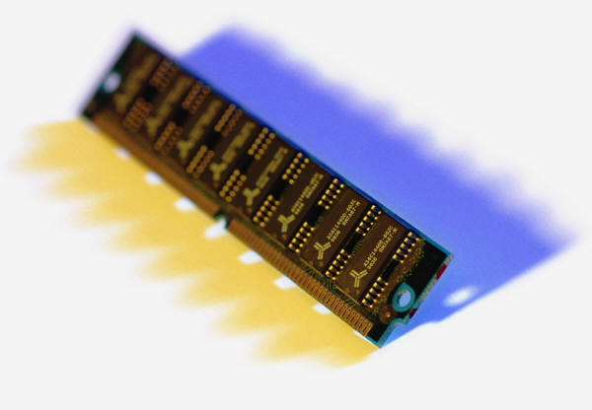
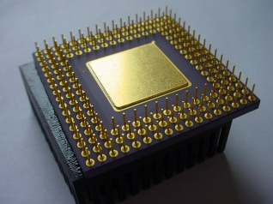
Bandwidth hierarchy
Cache
RAM
Local
disks
Local
rack
Remote
rack
Remote
datacenter

Slide 35
Today’s disks
Application
100MB/s
2TB

Slide 36
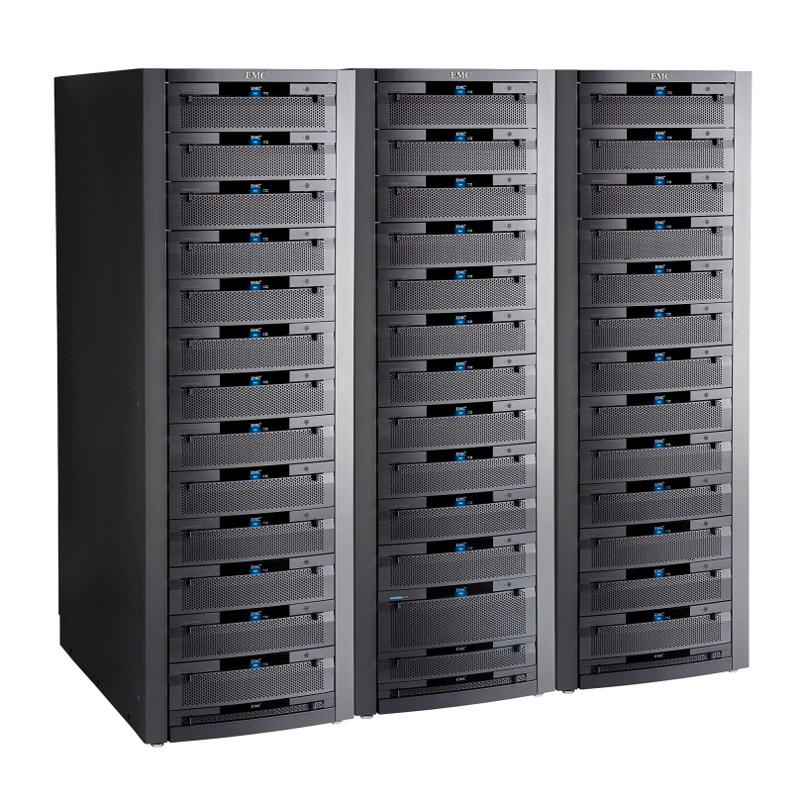
Storage bandwidth
Expensive
Fast network needed
Limited by network b/w
SAN
Cheap network
Cheap machines
Limited by disk b/w
JBOD

Slide 37
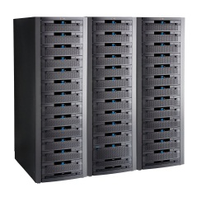
Time to read 1TB (sequential)
1 TB / 100MB/s = 3 hours
1 TB / 10 Gbps = 40 minutes
1 TB / (100 MB/s/disk x 10000 disks) = 1s
(1000 machines x 10 disks x 1TB/disk = 10PB)

Slide 38
Send the application to the data!
Application
100MB/s
2TB

Slide 39
Large-scale Distributed Storage
F[1]
File F
F[0]
F[1]
F[0]
Storage metadata service
Storage
Storage
Storage

Slide 40
Parallel Application I/O
App
ctrl
App
App
lookup
File F
F[0]
F[1]
Storage metadata service
Storage
Storage
Storage

Slide 41
Cluster Storage Abstraction
Set of reliable machines with a global filesystem
Cluster storage
Cluster services
Deployment
Machine
Machine
Machine
Machine

Slide 42
Distributed Execution:
Dryad
Applications
Language
Distributed Execution
Cluster storage
Cluster services
Deployment
Machine
Machine
Machine
Machine

Slide 43
Dryad = Execution Layer
Job (application)
Pipeline
≈
Dryad
Shell
Cluster
Machine
Notes:
In the same way as the Unix shell does not understand the pipeline running on top, but manages its execution (i.e., killing processes when one exits), Dryad does not understand the job running on top.

Slide 44
2-D Piping
Unix Pipes: 1-D
grep | sed | sort | awk | perl
Dryad: 2-D
grep¹⁰⁰⁰ | sed⁵⁰⁰ | sort¹⁰⁰⁰ | awk⁵⁰⁰ | perl⁵⁰
Notes:
Dryad is a generalization of the Unix piping mechanism: instead of uni-dimensional (chain) pipelines, it provides two-dimensional pipelines. The unit is still a process connected by a point-to-point channel, but the processes are replicated.

Slide 45
Virtualized 2-D Pipelines
Notes:
This is a possible schedule of a Dryad job using 2 machines.

Slide 46

Virtualized 2-D Pipelines

Slide 47

Virtualized 2-D Pipelines

Slide 48
Virtualized 2-D Pipelines

Slide 49
Virtualized 2-D Pipelines
2D DAG
multi-machine
virtualized
Notes:
The Unix pipeline is generalized 3-ways:
2D instead of 1D
spans multiple machines
resources are virtualized: you can run the same large job on many or few machines

Slide 50
Dryad Job Structure
Channels
Input
files
Stage
Output
files
grep
sort
awk
sed
perl
grep
sort
sed
awk
grep
sort
Vertices
(processes)
Notes:
This is the basic Dryad terminology.

Slide 51
Dryad System Architecture
data plane
Files, TCP, FIFO, Network
job schedule
V
V
V
NS,
Sched
RE
RE
RE
control plane
Graph manager
cluster
Notes:
The brain of a Dryad job is a centralized graph manager, which maintains a complete state of the job.
The GM controls the processes running on a cluster, but never exchanges data with them.
(The data plane is completely separated from the control plane.)

Slide 52
Separate Data and Control Plane
Different kinds of traffic
  Data = bulk, pipelined
  Control = interactive
Different reliability needs

Slide 53
Centralized control
Manager state is not replicated
Entire manager state is held in RAM
Simple implementation
Vertices use leases:
no runaway computations on manager crash
Manager crash causes complete job crash

Slide 54

Staging
1. Build
2. Send
.exe
7. Serialize
vertices
vertex code
Remote
execution
service
5. Generate graph
GM code
Name
server
6. Initialize vertices
3. Start manager
8. Monitor
Vertex execution
4. Query
cluster resources
Notes:
Computation Staging

Slide 55



Fault Tolerance
Notes:
Vertex failures and channel failures are handled differently.

Slide 56
Danger of Fault Tolerance
Fault tolerance can mask defects in other software layers
Log fault repairs
Review the logs periodically

Slide 57
Failures
Fail-stop (crash) failures are easiest to handle
Many other kinds of failures possible
  Very slow progress
  Byzantine (malicious) failures
  Network partitions
Understand the failure model for your system
  probability of each kind of failure
  validate the failure model (measurements)

Slide 58
Dryad Abstraction
Reliable machine running distributed jobs with
“infinite” resources
Distributed Execution
Cluster storage
Cluster services
Deployment
Machine
Machine
Machine
Machine

Slide 59

Interlude: Thinking in Parallel

Slide 60
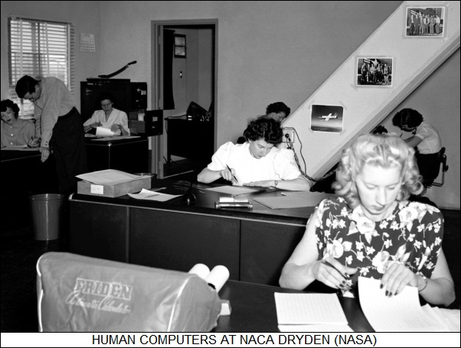
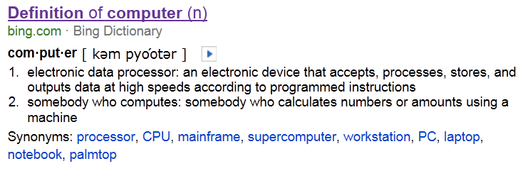
Computing
1930s
Image from: http://www.dayvectors.net/g2012m02.html

Slide 61


Logistics
= input data
+
= output data
= communication
is expensive

Slide 62

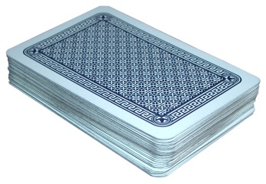
Playing Cards
suits
Clubs Diamonds Hearts Spades
2,3,4,5,6,7,8,9,10,J,Q,K,A
our order

Slide 63

Count the number of cards
Counting, or aggregation

Slide 64
Keep only the even cards
2,3,4,5,6,7,8,9,10,J,Q,K,A
Filter

Slide 65

Count the Number of Figures
Filter and Aggregate

Slide 66
Group cards by suit
GroupBy

Slide 67
Number of cards of each suit
? ? ? ?
GroupBy-Aggregate

Slide 68
Sort the cards
lexicographic
order
2,3,4,5,6,7,8,9,10,J,Q,K,A
Sort

Slide 69
DryadLINQ
Applications
Language
Distributed Execution
Cluster storage
Cluster services
Deployment
Machine
Machine
Machine
Machine

Slide 70
Collections
Collection<T>
Iterator
(current element)
Elements of type T

Slide 71

Distributed Collections
.Net objects
Partition
Collection

Slide 72
Collection = Collection of Collections
Collection<T>
Collection<T>

Slide 73
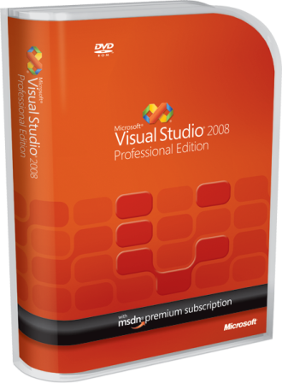
LINQ
=> DryadLINQ
Dryad
Notes:
DryadLINQ adds a wealth of features on top of plain Dryad.

Slide 74
LINQ = .Net+ Queries
Collection<T> collection;
bool IsLegal(Key);
string Hash(Key);
var results = from c in collection
where IsLegal(c.key)
select new { Hash(c.key), c.value};
Notes:
Language Integrated Query is an extension of .Net which allows one to write declarative computations on collections (green part).

Slide 75

DryadLINQ = LINQ + Dryad
Collection<T> collection;
bool IsLegal(Key k);
string Hash(Key);
var results = from c in collection
where IsLegal(c.key)
select new { Hash(c.key), c.value};
Vertex
code
Query
plan
(Dryad job)
Data
collection
C#
C#
C#
C#
results
Notes:
DryadLINQ translates LINQ programs into Dryad computations:
- C# and LINQ data objects become distributed partitioned files.
- LINQ queries become distributed Dryad jobs.
- C# methods become code running on the vertices of a Dryad job.

Slide 76
Language Summary
Where
Select
GroupBy
OrderBy
Aggregate
Join

Slide 77
DryadLINQ Abstraction
.Net with “infinite” resources
Language
Distributed Execution
Cluster storage
Cluster services
Deployment
Machine
Machine
Machine
Machine

Slide 78
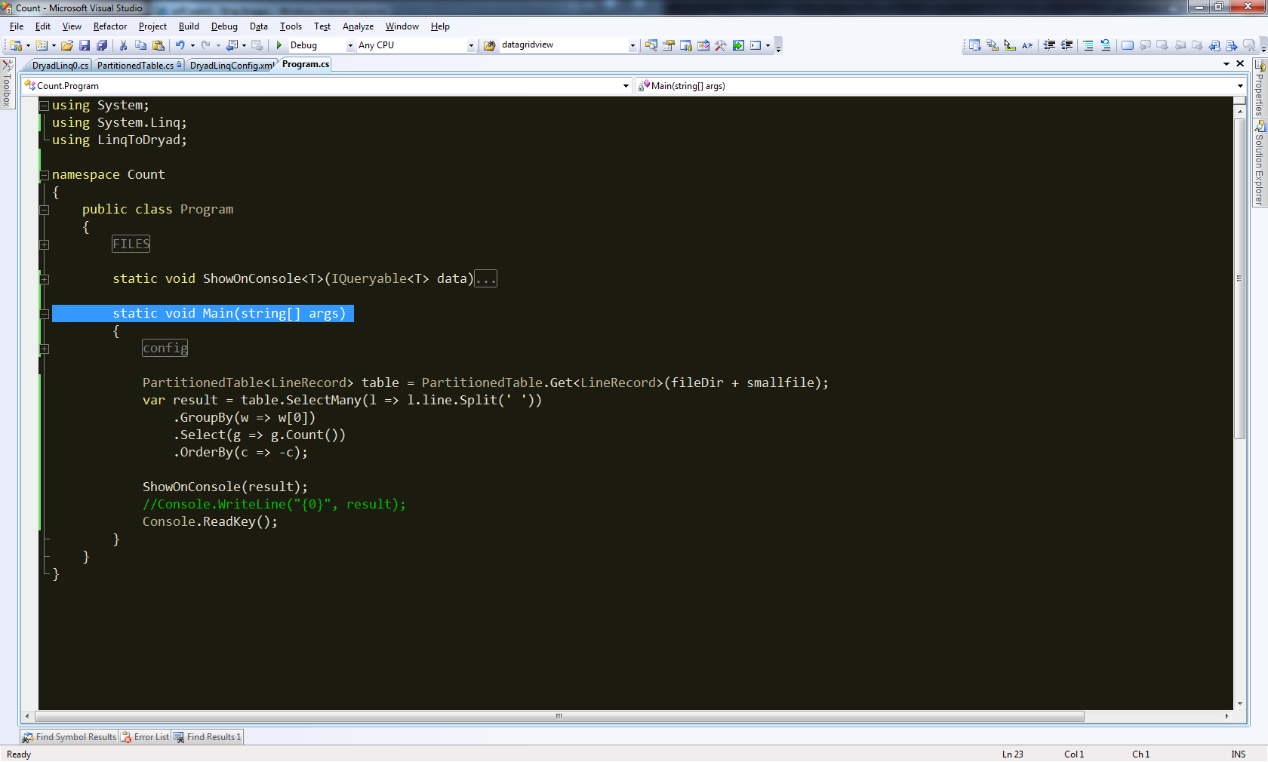
Demo

Slide 79
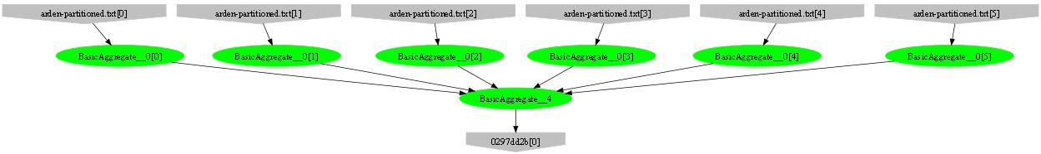
Example: counting lines
var table = PartitionedTable.Get<LineRecord>(file);
int count = table.Count();
Parse,
Count
Sum

Slide 80
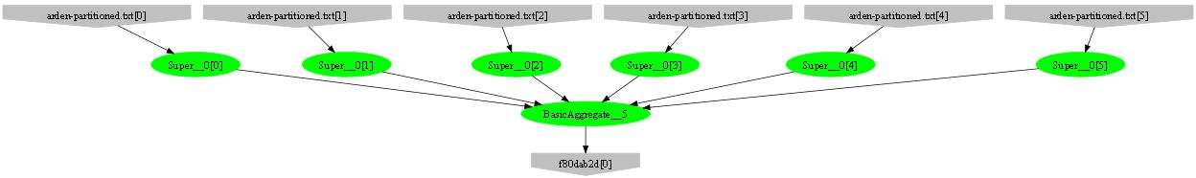
Example: counting words
var table = PartitionedTable.Get<LineRecord>(file);
int count = table
.SelectMany(l => l.line.Split(‘ ‘))
.Count();
Parse,
SelectMany,
Count
Sum

Slide 81
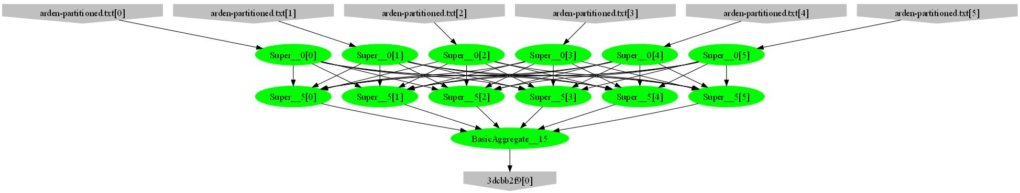
Example: counting unique words
var table = PartitionedTable.Get<LineRecord>(file);
int count = table
.SelectMany(l => l.line.Split(‘ ‘))
.GroupBy(w => w)
.Count();
HashPartition
GroupBy;
Count

Slide 82
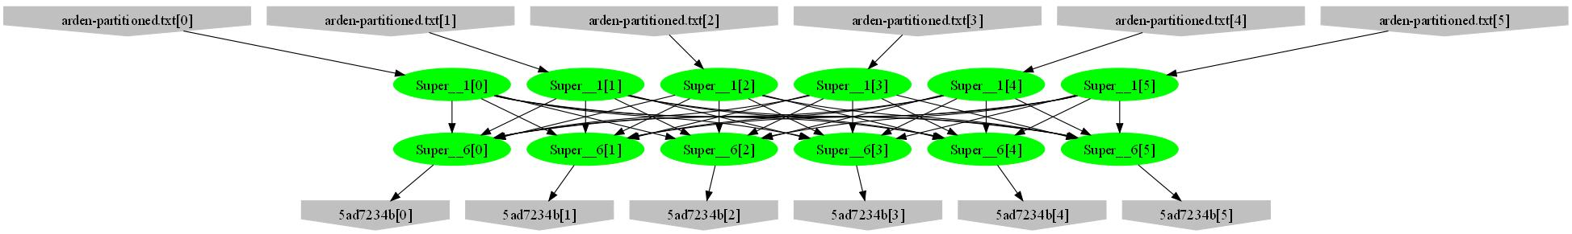
Example: word histogram
var table = PartitionedTable.Get<LineRecord>(file);
var result = table.SelectMany(l => l.line.Split(' '))
.GroupBy(w => w)
.Select(g => new { word = g.Key, count = g.Count() });
GroupBy
Count
HashPartition
GroupBy;
Count

Slide 83
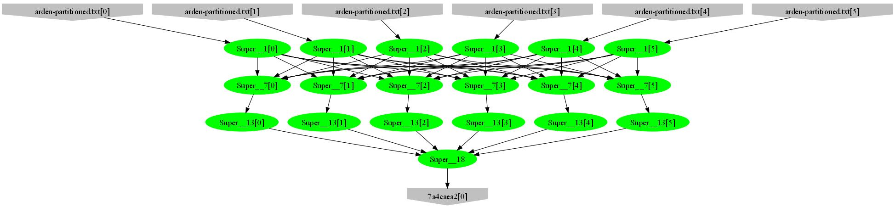
Example: high-frequency words
var table = PartitionedTable.Get<LineRecord>(file);
var result = table.SelectMany(l => l.line.Split(' '))
.GroupBy(w => w)
.Select(g => new { word = g.Key, count = g.Count() })
.OrderByDescending(t => t.count)
.Take(100);
Sort;
Take
Mergesort;
Take

Slide 84
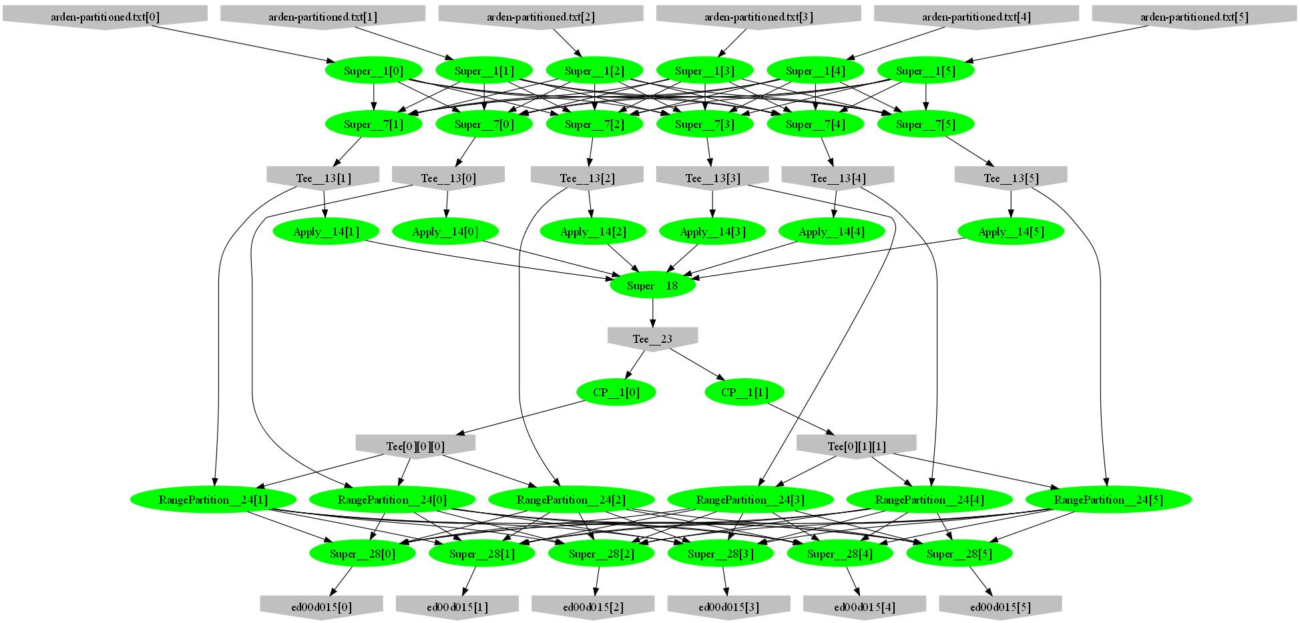
Example: words by frequency
var table = PartitionedTable.Get<LineRecord>(file);
var result = table.SelectMany(l => l.line.Split(' '))
.GroupBy(w => w)
.Select(g => new { word = g.Key, count = g.Count() })
.OrderByDescending(t => t.count);
Sample
Histogram
Broadcast
Range-partition
Sort

Slide 85
Example: Map-Reduce
public static IQueryable<S>
MapReduce<T,M,K,S>(
IQueryable<T> input,
Func<T, IEnumerable<M>> mapper,
Func<M,K> keySelector,
Func<IGrouping<K,M>,S> reducer)
{
var map = input.SelectMany(mapper);
var group = map.GroupBy(keySelector);
var result = group.Select(reducer);
return result;
}

Slide 86
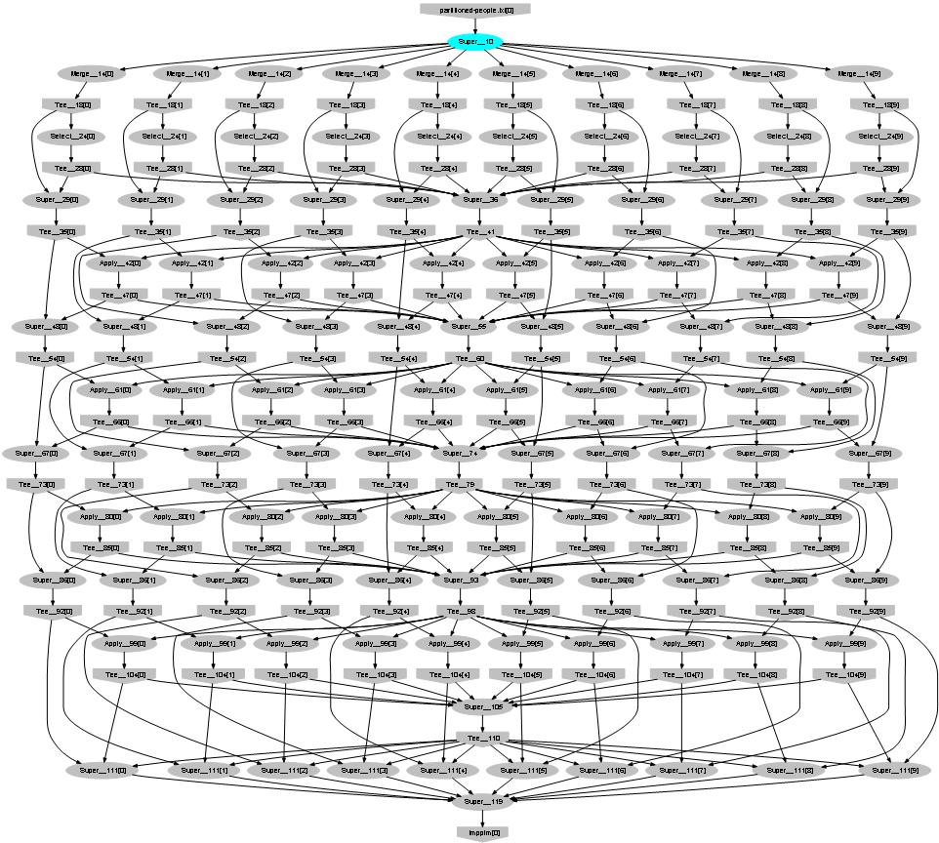
Probabilistic Index Maps
Images
features

Slide 87
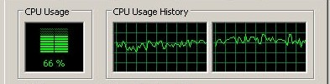

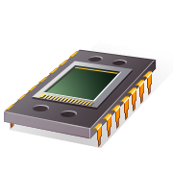
Parallelizing on Cores
Query
DryadLINQ
Local query
PLINQ

Slide 88

LINQ Design
Strong typing for data very useful
  Automatic serialization
  Detect complex bugs
LINQ extensibility is very powerful
  Running on very different runtimes
Managed code increases productivity by 10x10

Slide 89
More Tricks of the trade
Asynchronous operations hide latency
Management using distributed state machines
Logging state transitions for debugging
Compression trades-off bandwidth for CPU

Slide 90
BUILDING ON DryadLINQ
Applications
Language
Distributed Execution
Cluster storage
Cluster services
Deployment
Machine
Machine
Machine
Machine

Slide 91

So, What Good is it For?

Slide 92
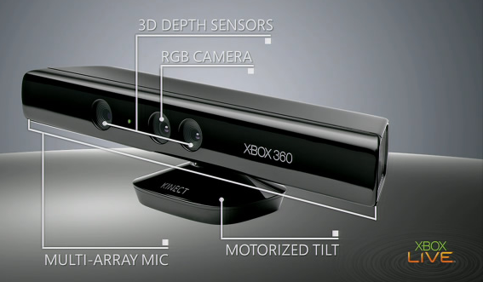
KINECT v1

Slide 93

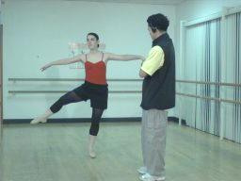
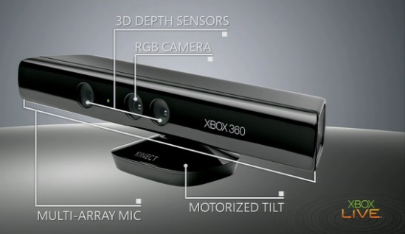

Data
Streams
Video
Depth
Audio

Slide 94

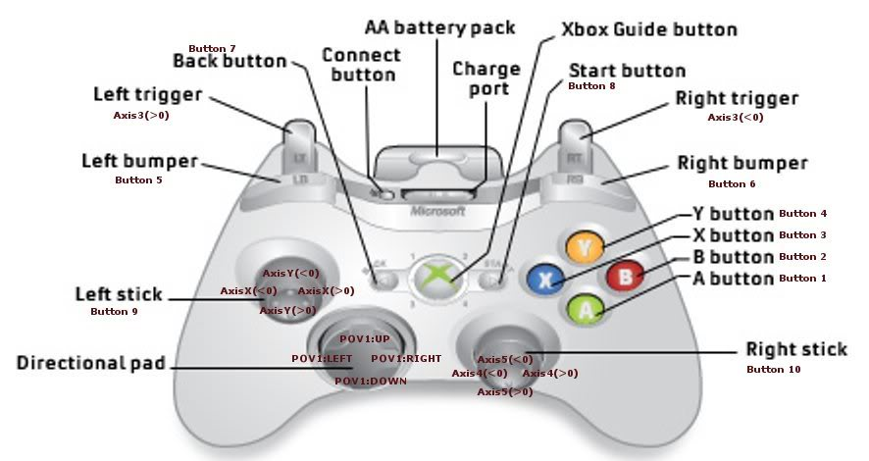
“You are the Controller”
source: forums.steampowered.com

Slide 95
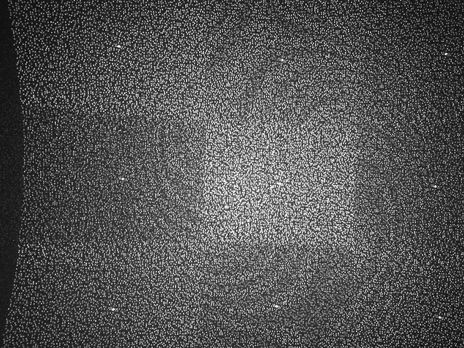
Projected IR pattern
Source: www.ros.org

Slide 96

Depth computation
Source: http://nuit-blanche.blogspot.com/2010/11/unsing-kinect-for-compressive-sensing.html

Slide 97

The Body Tracking Problem

Slide 98
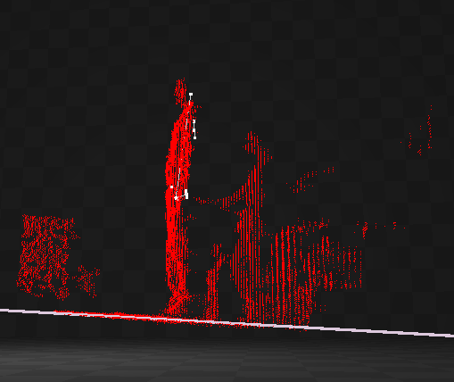
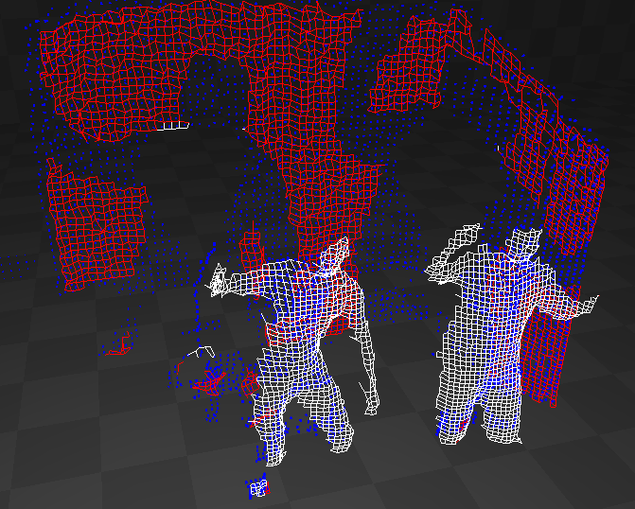

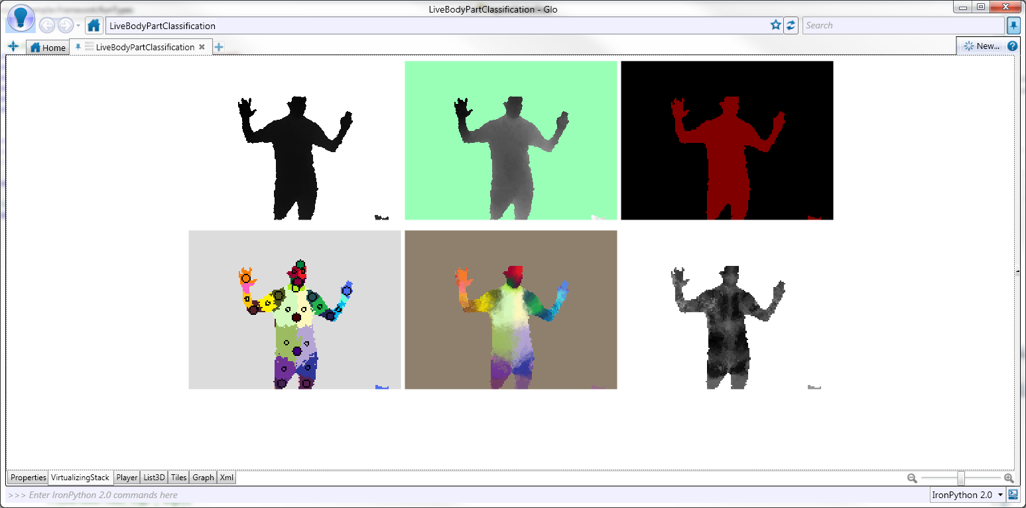

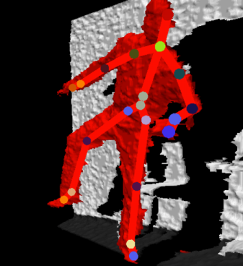
Tracking Pipeline
Sensor
Depth map
Background elimination
Player segmentation
Body Part Classifier
Body Part
Identification
Skeleton

Slide 99
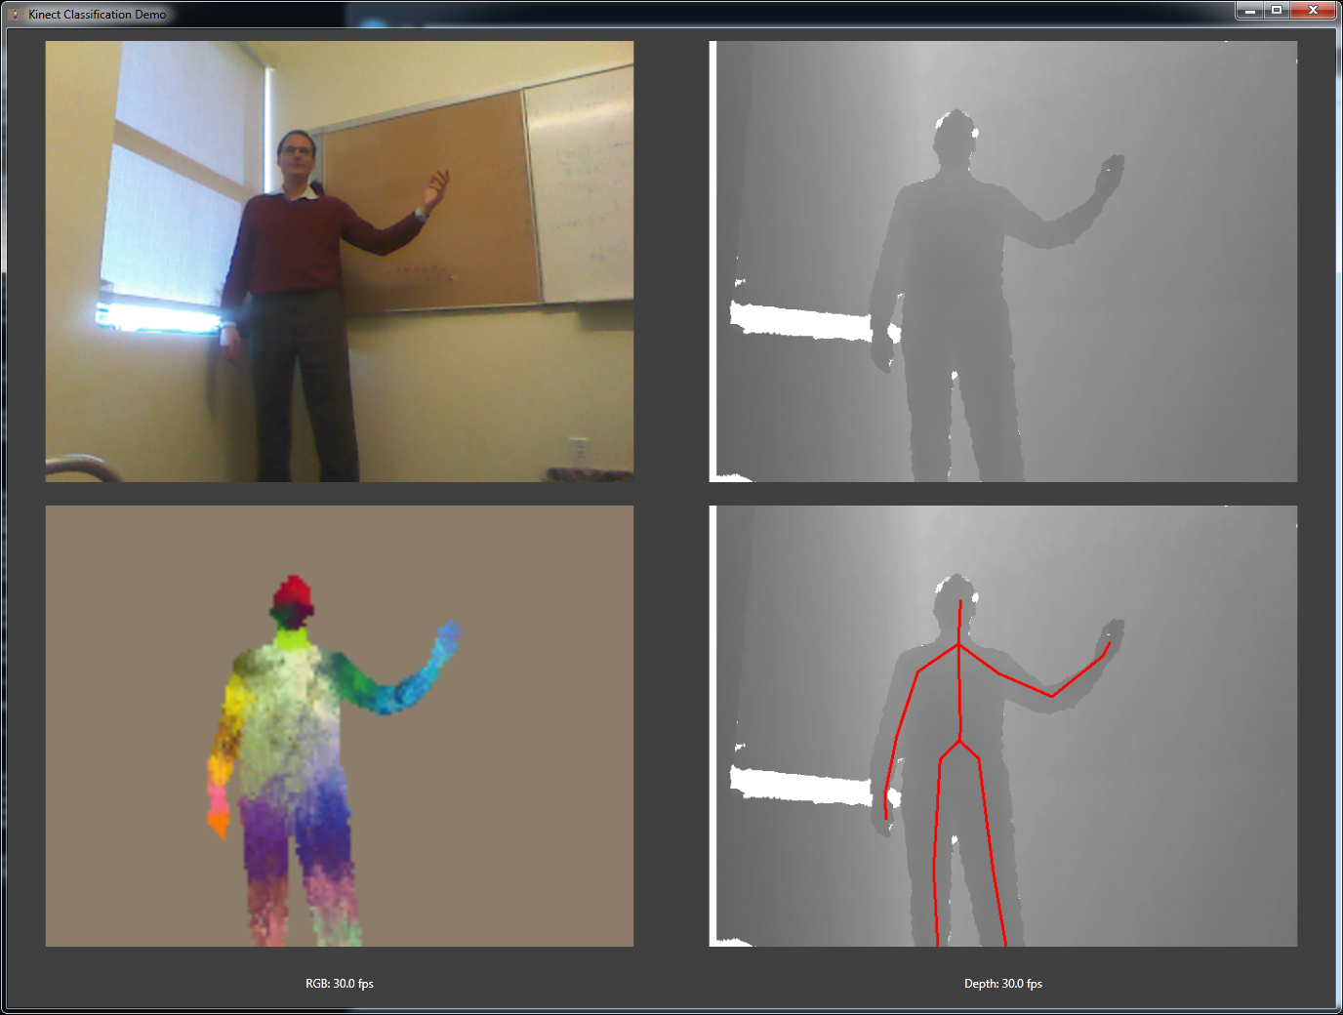

Slide 100
From Depth Map to Body Parts
Classifier
Depth map
Xbox GPU
Body parts

Slide 101

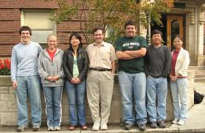

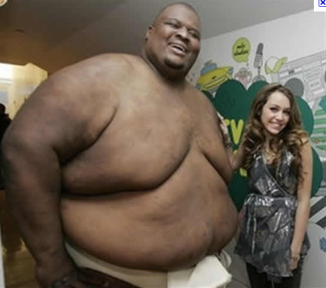






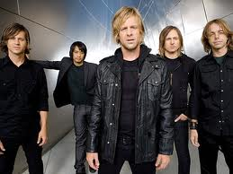

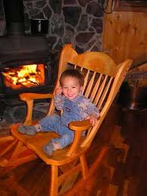

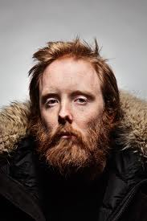










What is the Shape of a Human?
body size
hair
FOV
body type
clothes
angle
pets
furniture

Slide 102

How do You Recognize a Human?
“nose”

Slide 103



Learn from Examples
Classifier
Machine learning

Slide 104

Examples
source: www.fanpop.com

Slide 105


Motion Capture (Mocap)

Slide 106

Rendered Avatar Models

Slide 107




Ground Truth Data
noise

Slide 108
Decision Trees
<
>
<
Features to learn

Slide 109


Accuracy
24 hours/8 core machine

Slide 110

Learn from Many Examples
Decision
Tree
Classifier
Machine learning

Slide 111

Highly efficient parallellization
machine
time

Slide 112
The End

Slide 113















The Roaring ‘60s

Slide 114














The other ‘60s
Spacewars
PDP/8
ARPANET
Multics
Time-sharing
(defun factorial (n)
(if (<= n 1) 1
(* n (factorial (- n 1)))))
Virtual memory
OS/360

Slide 115



What about the 2010’s?

Slide 116
Layers
Applications
Programming Languages and APIs
Resource Management
Scheduling
Distributed Execution
Operating System
Caching and Synchronization
Storage
Identity & Security
Networking

Slide 117









Pieces of the Global Computer
And many, many more…

Slide 118

This lecture

Slide 119


The cloud
“The cloud” is evolving rapidly
New frontiers are being conquered
The face of computing will change forever
There is still a lot to be done
You might do it!

Slide 120
Bibliography (1)
Dryad: Distributed Data-Parallel Programs from Sequential Building Blocks
Michael Isard, Mihai Budiu, Yuan Yu, Andrew Birrell, and Dennis Fetterly
European Conference on Computer Systems (EuroSys), Lisbon, Portugal, March 21-23, 2007
DryadLINQ: A System for General-Purpose Distributed Data-Parallel Computing Using a High-Level Language
Yuan Yu, Michael Isard, Dennis Fetterly, Mihai Budiu, Úlfar Erlingsson, Pradeep Kumar Gunda, and Jon Currey
Symposium on Operating System Design and Implementation (OSDI), San Diego, CA, December 8-10, 2008
Hunting for problems with Artemis
Gabriela F. Creţu-Ciocârlie, Mihai Budiu, and Moises Goldszmidt
USENIX Workshop on the Analysis of System Logs (WASL), San Diego, CA, December 7, 2008
DryadInc: Reusing work in large-scale computations
Lucian Popa, Mihai Budiu, Yuan Yu, and Michael Isard
Workshop on Hot Topics in Cloud Computing (HotCloud), San Diego, CA, June 15, 2009
Distributed Aggregation for Data-Parallel Computing: Interfaces and Implementations,
Yuan Yu, Pradeep Kumar Gunda, and Michael Isard,
ACM Symposium on Operating Systems Principles (SOSP), October 2009
Quincy: Fair Scheduling for Distributed Computing Clusters
Michael Isard, Vijayan Prabhakaran, Jon Currey, Udi Wieder, Kunal Talwar, and Andrew Goldberg
ACM Symposium on Operating Systems Principles (SOSP), October 2009

Slide 121
Bibliography (2)
Autopilot: Automatic Data Center Management, Michael Isard, in Operating Systems Review, vol. 41, no. 2, pp. 60-67, April 2007
Distributed Data-Parallel Computing Using a High-Level Programming Language, Michael Isard and Yuan Yu, in International Conference on Management of Data (SIGMOD), July 2009
SCOPE: Easy and Efficient Parallel Processing of Massive Data Sets
Ronnie Chaiken, Bob Jenkins, Per-Åke Larson, Bill Ramsey, Darren Shakib, Simon Weaver, and Jingren Zhou, Very Large Databases Conference (VLDB), Auckland, New Zealand, August 23-28 2008
Incorporating Partitioning and Parallel Plans into the SCOPE Optimizer, Jingren Zhou, Per-Åke Larson, and Ronnie Chaiken, in Proc. of the 2010 ICDE Conference (ICDE’10).
Nectar: Automatic Management of Data and Computation in Datacenters, Pradeep Kumar Gunda, Lenin Ravindranath, Chandramohan A. Thekkath, Yuan Yu, and Li Zhuang, in Proceedings of the 9th Symposium on Operating Systems Design and Implementation (OSDI), October 2010
Optimus: A Dynamic Rewriting Framework for Execution Plans of Data-Parallel Computations,
Qifa Ke, Michael Isard, Yuan Yu, Proceedings of EuroSys 2013, April 2013

Slide 122
Data-Parallel Computation
Application
SQL
Sawzall, Java
≈SQL
LINQ, SQL
Parallel
Databases
Sawzall,FlumeJava
Pig, Hive
DryadLINQ
Scope
Language
Map-Reduce
Hadoop
Dryad
Execution
GFS
BigTable
HDFS
Cosmos
Storage

